Slide 1

EDGD801
Learning and behaviour
Behaviour management strategies
Lecture 1 - Planning for learning
March 3
Presented by Ray Handley

Slide 2
Overview of the next 2 weeks
Background and principles
Keeping your cool
Understanding the students
Crisis development model
Positive Behaviour models
Practical guide to survival in the classroom
Notes:
2

Slide 3
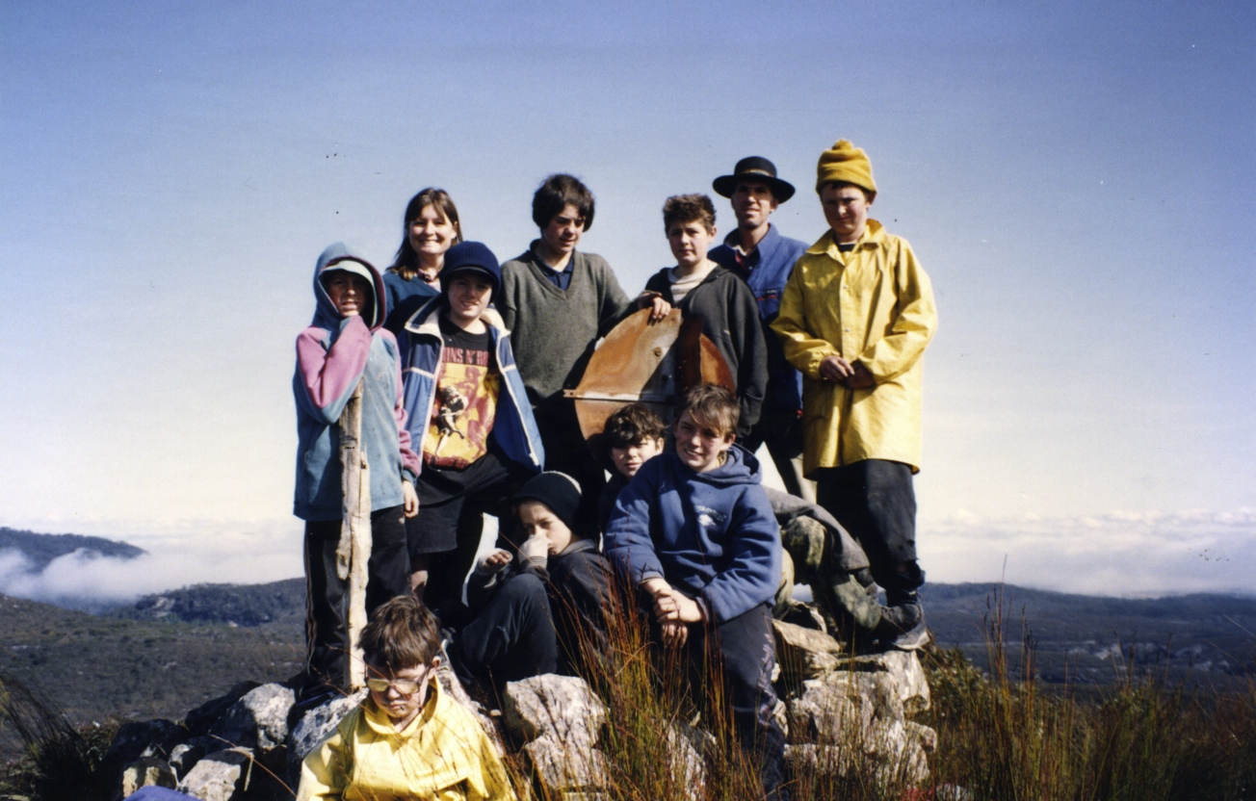
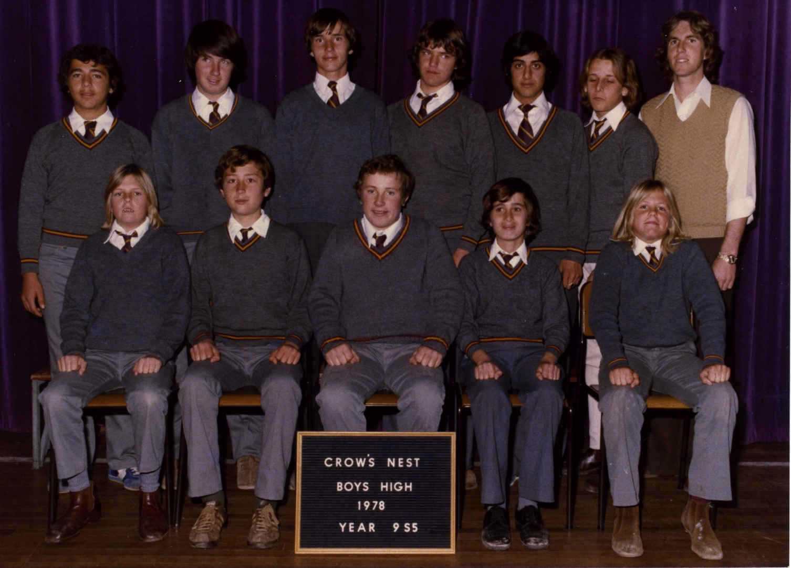
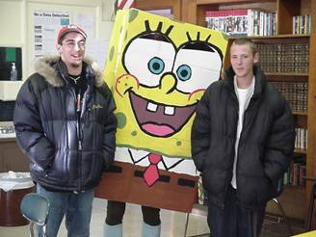
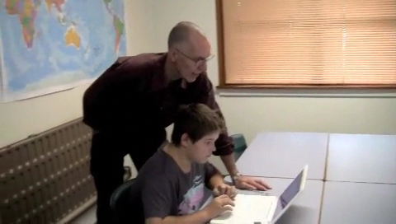
. . . a bit of history
. . . a bit of my history
Head teacher – Campbelltown Suspension Centre
Wilderness enhanced program
General teacher
Principal – alternative school, Maine, USA

Slide 4
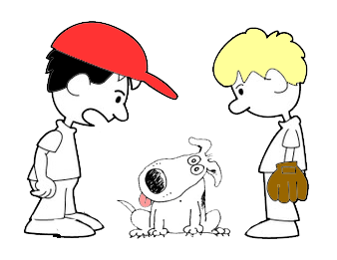
I’ve taught my dog to talk
But your dog can’t talk
I know.
I said I taught him not
that he learnt how to do it.

Slide 5

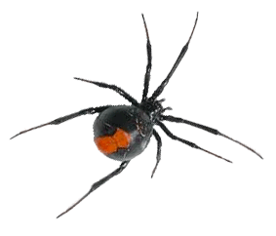

Where do they come from
Where do behaviour issues come from?
Teachers
expectations
skills
personality
Content
Past experiences
curriculum
accessibility
relevance
learning issues
motivation
Students
needs
goals
attitudes
Outside influences
School systems
socio-economics
peers
family
environment
assessment
discipline systems

Slide 6

the quality skills of teaching
(NSW DEC)
The word ‘pedagogy’ originated from the Greeks, to mean “child” and “lead”, then put them together to get a literal meaning – “to lead the child”.
In Ancient Greece, a slave (paidagogos) was assigned to a wealthy master’s son, to take him to school, supervise him while in school, and carrying his equipment such as musical instruments.
activities that impart knowledge
(University of Tasmania)
the art or science of teaching; education; instructional methods.
(Dictionary.com)
the art of teaching
(Qld DET)
Let’s talk ‘pedagogy’

Slide 7


Palate
PEDAGOGY - getting the right mix
Information
TEACHERTRAINING
TEACHERPRACTICE
Information
Information
Philosophy
Philosophy
Philosophy
Skills
Skills
Skills
Personality
Personality
Personality

Slide 8




Plan
principles & philosophy
Framework
personal
theories & approaches
skills & strategies
Models
Practice
researched & understood
applied & reviewed

Slide 9

Framework
Framework for Teaching
consistent
A approach with sound, well communicated principles,
that allows actions
in response to individual circumstances,
flexible
ongoing
and reflects an belief
in the inevitability of change

Slide 10
Models
Models for Teaching
teacher centred
learning is a response to changes in the environment in which it occurs
Behaviourist approaches
reward/punishment
+ve/-ve reinforcement
teacher centred
learning results from changes in thinking
Cognitive approaches
looks for patterns & beliefs
student centred
Constructivist approach
learning is an active process of creating meaning from different experiences
teacher is a guide to learning
Notes:
Behaviourist and cognitive - teacher centred. Change behaviour by either changing the situation in which the beahviour occurs (environment through rewards, consequences, punishments, reinforcements or by changing the thinking behind the behaviour ( attitudes, beliefs, self talk, intentions)
Constructivist approach is student centred. This theory states that learning is an active process of creating meaning from different experiences. In other words, students will learn best by by trying to make sense of something on their own with the teacher as a guide to help them along the way. (Brooks, J. and Brooks, M. (1993). In Search of Understanding: The Case for Constructivist Classrooms, ASCD)

Slide 11

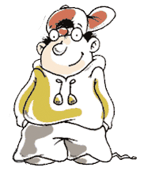
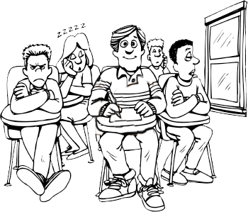
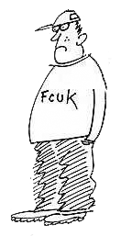
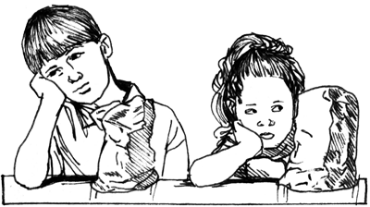
Student qualities
Ability
Can do
Can’t do
Selective
Schools
Will do
Student Qualities
SSPs
Special
Units
Motivation
Won’t
Behaviour
Schools
Mainstream schools

Slide 12
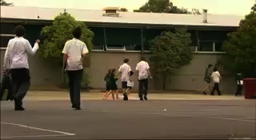
Jonah
Ability
Can do
Can’t do
Will do
Student Qualities
Motivation
Won’t

Slide 13
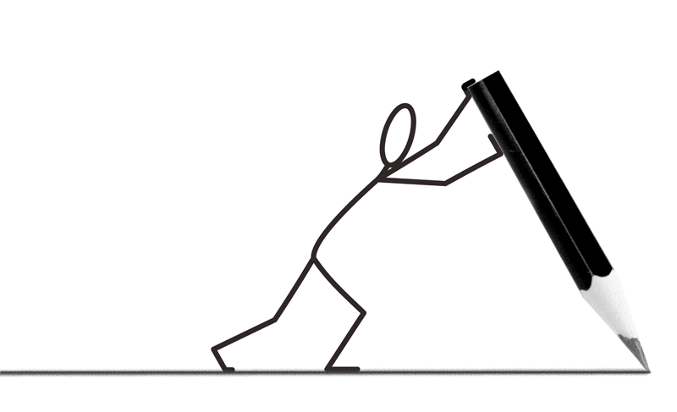
Next . . . . . . Rational detachment
Acceptable/unacceptable behaviours - drawing the line

Slide 14



Letting go while staying connected
The ability to stay in control of one’s own behaviour and not take acting out behaviour personally
Can’t control many factors but staff can control their own response to acting out behaviours
Self control is needed to avoid overreacting or acting inappropriately
KEY POINTS
Need to find positive outlets for negative energy absorbed during a crisis
Find your own warning cues and ways to detach at home, at work and in a crisis
Based on training materials from the Crisis Prevention Institute Milwaukee USA

Slide 15
A WINDOW ON BEHAVIOUR
Problem owned by others
Response to focus on the problem
Personal feelings and thoughts explained
Stress is controlled by you
Remedies
Acceptable Behaviours
breathe
humour
change course
take a break . .
(detached/calm)
All
behaviours
experienced
Line of responsibility
Symptoms
sick feeling
sweating
panic
raised voice
Problem owned by us
Reaction that focuses on blame and denial
Personal attack used to fight back and hurt other person
Generalisations & absolutes
Stress controls you
Unacceptable behaviours
(taken personally)
adapted from Thomas Gordon (1974) Teacher Effectiveness Training. Wyden Publishing, NY.

Slide 16


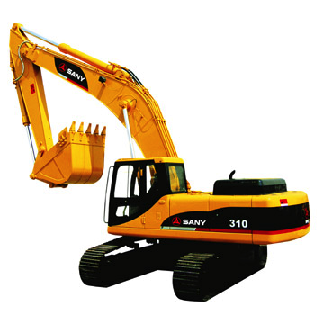
Words and expressions we use when we own the problem
. . . and lose our rational detachment
Why don’t you . . . . . ?
When are you . . . . . ?
But . . . . .
roadblocks
You should . . . . .
excavators
Every time I . . . . .
You never . . . . .

Slide 17
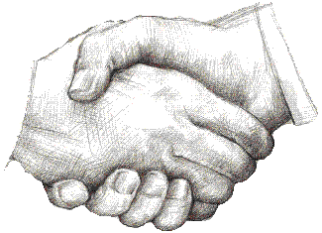
Words and expressions we use to enable other people to resolve an issue
What happened . . . . . ?
What can I do to . . . . . ?
. . . and . . . . .
Is it worth it ?
Sometimes I . . . . .
What is different about . . . . . ?
What would you do if you were in my shoes?

Slide 18

Letting go control - holding on to the relationship

Slide 19

Letting go control - holding on to the relationship
for an interview with Capt. Sullenberger explaining how he coped with the situation . . . click
Some more key points . . .
acknowledge emotions and then focus on the task at hand
have a plan and know the next step
develop the skills and be ready to use them in a variety of situations
know what to avoid and maintain a focus on getting the task done

Slide 20


Letting go control - holding on to the relationship
Some similarities with fishing . . . .
Gear or tools
These must be good quality, in good
working order and right for the conditions
Bait
Must be desirable to the type of fish you are after otherwise you will not get a bite.
Timing
Important otherwise opportunities will be lost
Location
Time and place must both be right or you will be casting into an empty sea
Patience
Conditions change so the opportunity may come along with time.
Perseverance
If at first you don’t succeed, keep trying.

Slide 21
Letting go control - holding on to the relationship
Some tips for success . . . .
Stay in the boat or on the rocks. In the water you’ll only get wet and cold.
If the fish aren’t biting cast around.
To go after big fish you’ll have to cast in deep water
You’ll have a few disappointments. Come back another time.
Be creative. It’s not the size of the hook or the thickness of the line but how you play the game that is important.

Slide 22

References:
Mergel, B. 1998 Instructional Design & Learning Theory. University of Saskatchewan, viewed on January 24 2011, http://www.usask.ca/education/coursework/802papers/mergel/brenda.htm
Woolfolk, A. & Margetts, K. 2010 Educational Psychology 2nd Edition, Pearson, Australia. Chapter 1

