Slide 1

EDGD801
Learning and behaviour
Behaviour management strategies
Lecture 3
Models continuum
Positive behaviour model
March 10 – 2:30pm
Presented by Ray Handley

Slide 2
This week
Models continuum
Autocratic, teacher-centred approaches
Integrating learning and behaviour – Kounin
Positive behaviour model – Jones
Key skills - Detachment
- Tactical ignoring
- Limit setting the key to discipline

Slide 3
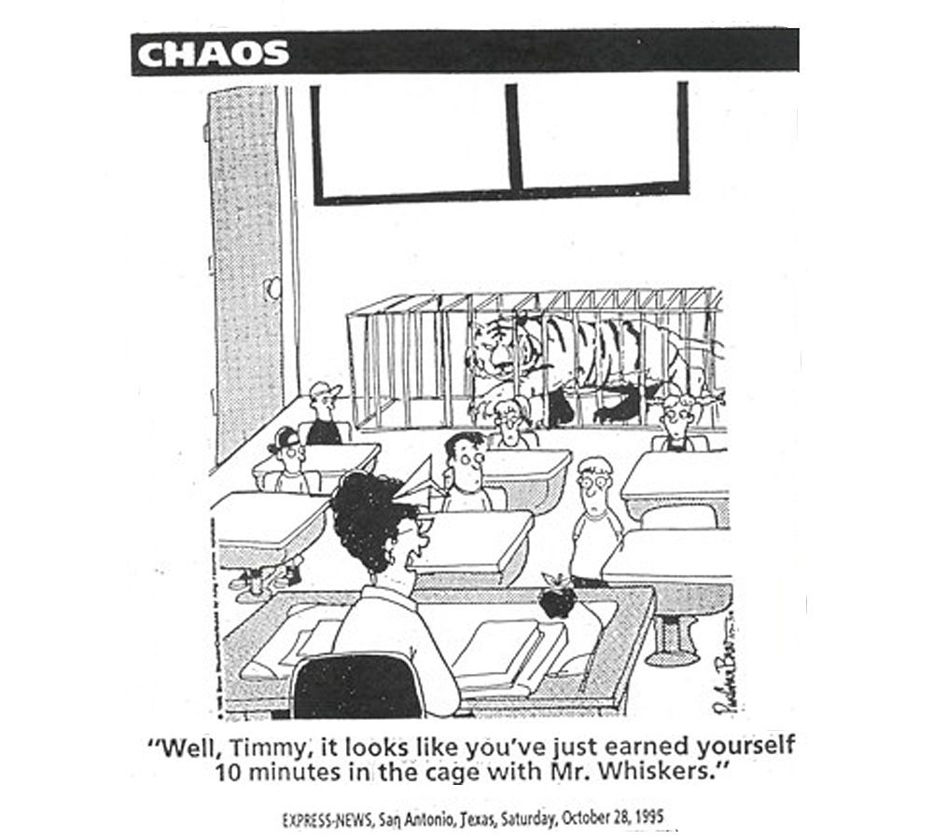
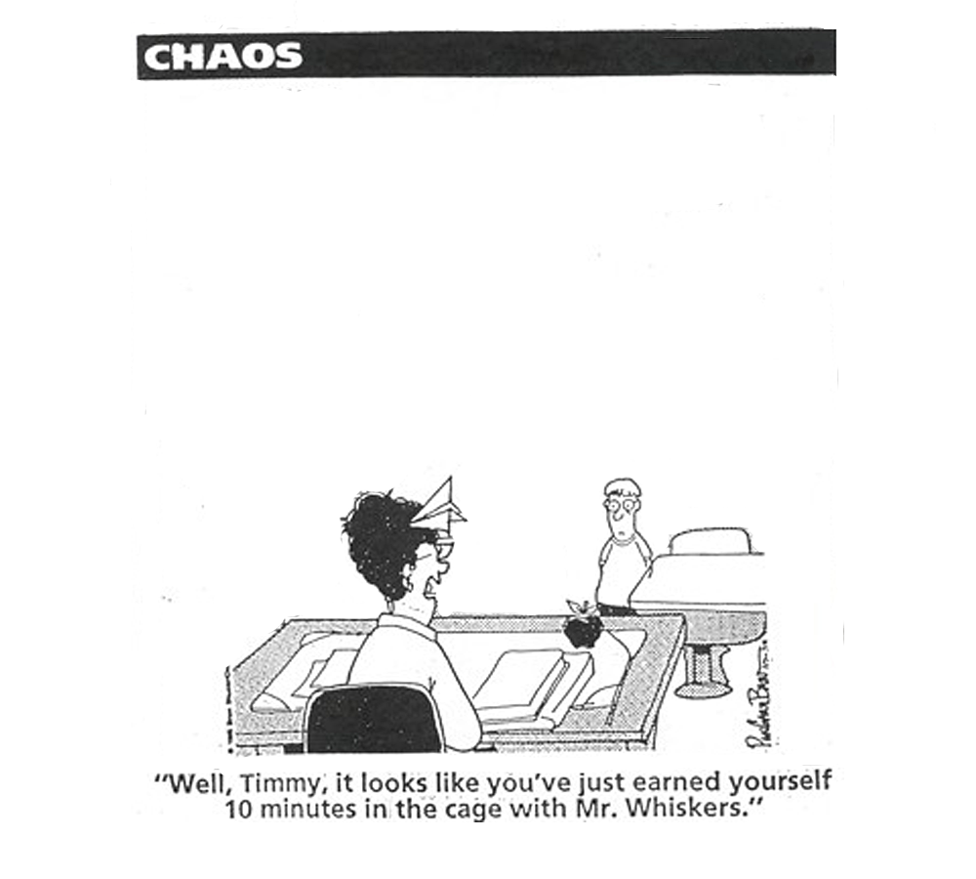

Slide 4
The Approaches or Models
Fred Jones - Positive Discipline
Jacob Kounin - Preventative discipline
Canter & Canter - Assertive Discipline
B.F. Skinner - Applied Behaviour Analysis
Integration of teaching and discipline
Ripple Effect, Withitness, Overlapping, Effective Transitions, Group Focus, Satiation
4Rs - rights, rules, responsibilities, routines
Clear behaviour plan
Avoid secondary behaviours
Clear rules/consequences
Positive reinforcement
Firm teacher role
Meeting needs of students
Creative/divergent thinking
Mastery learning
Focus on actions
Functional assessment
Planned response
Positive interactions
Encouragement not praise
Negotiation
Democratic relationships
Cost of praise
Understanding goals of behaviour
Body language
Incentives
Positive relationships
Focus on thinking
Challenging beliefs
Planning changes
Bill Rogers
Decisive Discipline
Looking for exceptions
Doing it differently
Scaling
William Glasser
Quality Schools
Cognitive Behavioural - Ellis, Wragg, Peterson
Understanding behaviour - Dreikurs, Balson
Haim Ginott, Carl Rogers - Humanist approaches
Strengths Based Intervention - Durrant, Kowalski

Slide 5

Bill Rogers
Decisive Discipline
Humanism
Ginott/Rogers
Jacob Kounin
Group Management
Fred Jones
Positive Discipline
Neo-Adlerian
Balson/Dreikurs
Systems Theory
Solution focussed
Applied Behaviour
Analysis
Behaviour Modification
Choice Theory
William Glasser
Canter & Canter
Assertive Discipline
Cognitive-behaviourism
Models of Behaviour Management Continuum
Student empowered
Internal motivation
Autocratic
Limit Setting
Laissez-faire
Non-directive
Teacher empowered
External motivation
Democratic
Leadership

Slide 6

Jacob Kounin
Group Management
Fred Jones
Positive Discipline
Models of Behaviour Management Continuum
Autocratic
Limit Setting
Democratic
Leadership
Laissez-faire
Non-directive

Slide 7
Preventive Discipline -
Jacob Kounin
teaching and discipline need to be integrated
interested, stimulated and active learners reduce the risk of disruptive behaviour
planned and coordinated activities within lessons reduce the likelihood of disruptive behaviour
a positive, productive classroom atmosphere or tone is pervasive for all participants

Slide 8
Preventive Discipline -
Jacob Kounin
By correcting misbehaviours in one student, it often influences the behaviour of nearby students
Conversely, noticing positive behaviour in one or a small group of students draws the attention of the others to your expectations
Ripple effect
Withitness
Overlapping
Smoothness
Momentum
Group alerting
Kounin, Jacob S. (1970) Discipline and Group Management in Classrooms. Holt, Rinehart and Winston, Inc.
TEXT from http://wik.ed.uiuc.edu/index.php/Kounin,_Jacob

Slide 9
Preventive Discipline -
Jacob Kounin
Ripple effect
Always be alert to sights and sounds in the classroom.
Arrange the seats so that students are always within eyesight.
Scan the room when working with individuals or small groups of students. When helping an individual make sure that you do not have your back to the rest of the class.
Briefly acknowledge misbehavior at first detection to let the class know that you know. Do not let the misbehaviour escalate before action is taken.
Withitness
Overlapping
Smoothness
Momentum
Group alerting
Kounin, Jacob S. (1970) Discipline and Group Management in Classrooms. Holt, Rinehart and Winston, Inc.
TEXT from http://wik.ed.uiuc.edu/index.php/Kounin,_Jacob

Slide 10
Preventive Discipline -
Jacob Kounin
Ripple effect
Withitness
When instructing one group, the teacher should be able to acknowledge difficulties that students outside of the group may be having so that instruction continues moving.
This also includes distractions from outside the classroom such as notes from the office or students walking through the hallways.
Overlapping
Smoothness
Momentum
Group alerting
Kounin, Jacob S. (1970) Discipline and Group Management in Classrooms. Holt, Rinehart and Winston, Inc.
TEXT from http://wik.ed.uiuc.edu/index.php/Kounin,_Jacob

Slide 11
Preventive Discipline -
Jacob Kounin
Ripple effect
Preplan the lesson so that extraneous matters are realised ahead of time and taken care of. Supplies for the class should always be preorganised before class begins and close to where they will be used.
Once students are doing their work and engaged, do not distract them. Leave them to their work and assist individuals with questions or needs.
Withitness
Overlapping
Smoothness
Momentum
Group alerting
Kounin, Jacob S. (1970) Discipline and Group Management in Classrooms. Holt, Rinehart and Winston, Inc.
TEXT from http://wik.ed.uiuc.edu/index.php/Kounin,_Jacob

Slide 12
Preventive Discipline -
Jacob Kounin
Ripple effect
Keep the lesson moving briskly.
Do not over-dwell on a minor or already understood concept.
Correct students without nagging and quickly return to the lesson.
Have students move from one activity to the next without being forced to wait for each other and each step in the transition.
Withitness
Overlapping
Smoothness
Momentum
Group alerting
Kounin, Jacob S. (1970) Discipline and Group Management in Classrooms. Holt, Rinehart and Winston, Inc.
TEXT from http://wik.ed.uiuc.edu/index.php/Kounin,_Jacob

Slide 13
Preventive Discipline -
Jacob Kounin
Ripple effect
Calling on students at random by asking a question only after scanning the room to make sure students are paying attention.
Raising group interest by interspersing suspense between questions.
Having the entire class respond in unison.
Physically moving around the room and asking students to show what they have done.
Asking one student to respond and looking at others.
Withitness
Overlapping
Smoothness
Momentum
Group alerting
Kounin, Jacob S. (1970) Discipline and Group Management in Classrooms. Holt, Rinehart and Winston, Inc.
TEXT from http://wik.ed.uiuc.edu/index.php/Kounin,_Jacob

Slide 14
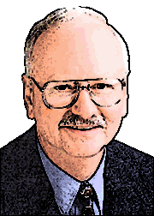
Positive Discipline -
Fred Jones
Classroom management procedures must . . . .
be positive and gentle.
set limits and build cooperation in the absence of coercion
be economical, practical and simple
ultimately reduce the teacher's work load.
offer incentives and encouragement for positive effort
Jones, Fred (2000) Tools for Teaching. Santa Cruz, CA: Frederick Jones and Associates.

Slide 15
Positive Discipline -
Fred Jones
Three different management methods are integrated to form a three-tier approach to discipline management.
‘limit-setting and relationship building form a tier of the management system which we might best describe as the interpersonal-interactive level of management.’
Limit-setting
from http://www.fredjones.com/Positive_Discipline/Discipline_Ch18.html

Slide 16
Positive Discipline -
Fred Jones
Three different management methods are integrated to form a three-tier approach to discipline management.
Limit-setting
make the exchange of positive and negative sanctions prearranged, explicit, concrete, and public.
Incentive systems
from http://www.fredjones.com/Positive_Discipline/Discipline_Ch18.html

Slide 17
Positive Discipline -
Fred Jones
Three different management methods are integrated to form a three-tier approach to discipline management.
Limit-setting
negative sanctions provide a disincentive, or the containment of behaviour when co-operation is lost
Incentive systems
Back-up systems
from http://www.fredjones.com/Positive_Discipline/Discipline_Ch18.html

Slide 18
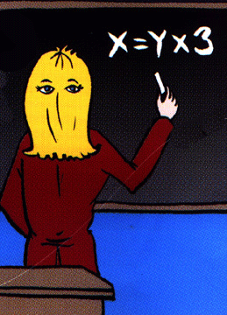
Positive Discipline -
Fred Jones
There are seven steps in limit setting:
Eyes in the back of your head

Slide 19

Positive Discipline -
Fred Jones
There are seven steps in limit setting:
Stop what you are doing and concentrate on the disruption
Eyes in the back of your head
Terminate Instruction

Slide 20
Positive Discipline -
Fred Jones
There are seven steps in limit setting:
Stop what you are doing and concentrate on the disruption
Face the student, make eye contact, and remain calm
Eyes in the back of your head
Terminate Instruction
Turn, look, and say the student’s name

Slide 21
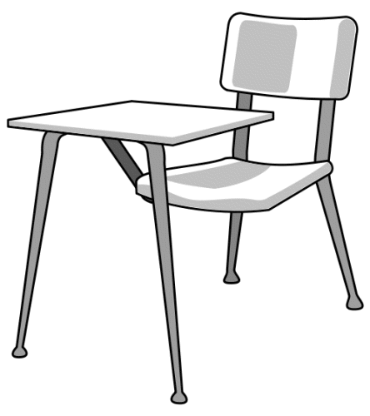

Positive Discipline -
Fred Jones
There are seven steps in limit setting:
Face the student, make eye contact, and remain calm
Eyes in the back of your head
Walk calmly to the front of the student’s desk and avoid comments
Terminate Instruction
Turn, look, and say the student’s name
Walk to the edge of the student’s desk

Slide 22
Positive Discipline -
Fred Jones
There are seven steps in limit setting:
Eyes in the back of your head
Walk calmly to the front of the student’s desk and avoid comments
Demonstrate what is expected
Terminate Instruction
Turn, look, and say the student’s name
Walk to the edge of the student’s desk
Prompt

Slide 23
Positive Discipline -
Fred Jones
There are seven steps in limit setting:
Eyes in the back of your head
Demonstrate what is expected
Lean towards the student
Terminate Instruction
Turn, look, and say the student’s name
Walk to the edge of the student’s desk
Prompt
Palms

Slide 24
Positive Discipline -
Fred Jones
There are seven steps in limit setting:
Eyes in the back of your head
Shift and maintain eye contact to show you are still aware
Lean towards the student
Terminate Instruction
Turn, look, and say the student’s name
Walk to the edge of the student’s desk
Prompt
Palms
Camping out

Slide 25


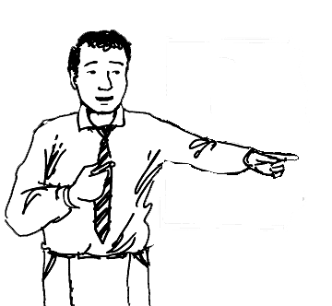
Setting limits
Redirecting students back to their behaviour and
creating a dilemma for which a decision is needed
Setting a limit is not the same as issuing an ultimatum.
If you don’t finish the work you will stay back at lunch.
ultimatum

Slide 26

Setting limits
Redirecting students back to their behaviour and
creating a dilemma for which a decision is needed
Setting a limit is not the same as issuing an ultimatum.
You can finish the work now and go out to lunch with the others or if it is unfinished you will stay back at lunch and I can help you with it. You decide.

Slide 27
Setting limits
Redirecting students back to their behaviour and
creating a dilemma for which a decision is needed
Setting a limit is not the same as issuing an ultimatum.
The purpose of limits is to teach, not to punish.
Through limits, people begin to understand that their actions, positive or negative, result in predictable consequences. By giving such choices and consequences, a structure for good decision making is provided.

Slide 28
Setting limits
Redirecting students back to their behaviour and
creating a dilemma for which a decision is needed
Setting a limit is not the same as issuing an ultimatum.
The purpose of limits is to teach, not to punish.
Setting limits is more about listening than talking.
By listening, you will learn more about what’s important to students, and that will help you set more meaningful limits.

Slide 29
Setting limits
directly
Explain which behaviour
is inappropriate
Be prepared to enforce
your consequences.
5
Explain why the behaviour is inappropriate.
Steps
Allow time.
Give reasonable choices
with consequences.

Slide 30


Setting limits
Refocus
on primary behaviour/main issue
& away from personal issues
Agree
with feelings/emotion
non-directly / strategically
Negotiate
What can I do to …..
Reinforce
Instances of difference (past experiences)
Behaviour of others
Issue continues
Issue resolved

Slide 31
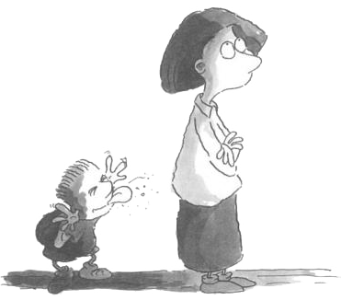
Tactical ignoring
Tactical ignoring is a conscious decision to ignore certain behaviour and keep the focus on the flow of the lesson, or on acknowledging and reinforcing positive behaviour.
For example - a teacher ignores several students calling out. A general rule reminder is given to the whole class:
'Remember our rule for hands up, everyone.'
Rogers, B. (2007) Behaviour Management: A Whole-School Approach. UK: Sage (p139)

Slide 32
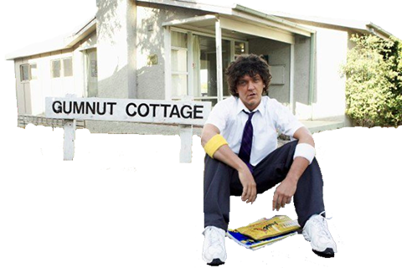

Tactical ignoring

Slide 33
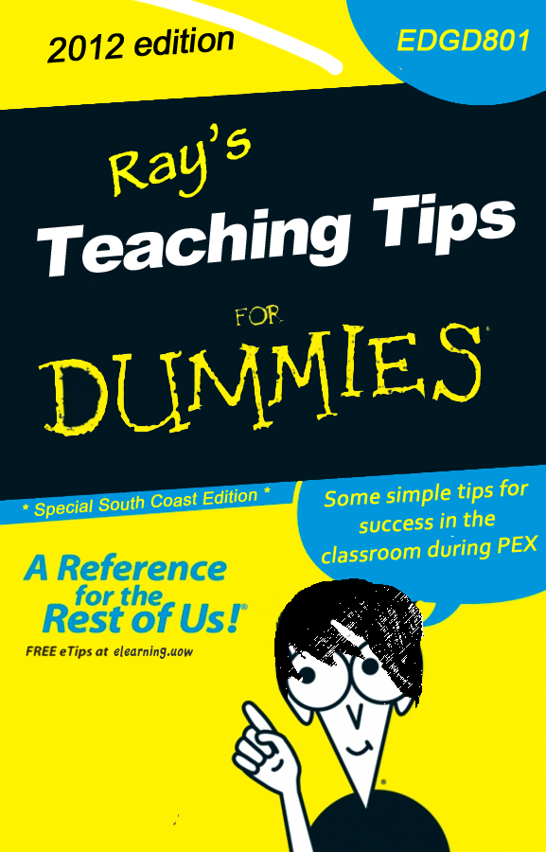
2013
The ‘ FOR DUMMIES’ series of publications and website resources is the property of Wiley Publishing, Inc. All rights reserved.
Find out more: http://au.dummies.com/Section/index.html

Slide 34
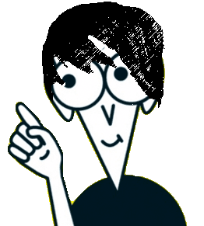
Contents
Introduction
9 tips for survival in the classroom
Realistic expectations
A thick skin
The moving target
More than intentions
Button pushing
More poker than pedagogy
Use your instincts
Keep cool
Chunk/funk/dunk
Ray’s Teaching tips for dummies

Slide 35
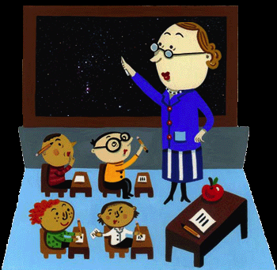
Introduction
You’ve done the MindMap, looked at many of the theories and seen some of the approaches recommended.
So what happens now. . .
Here’s a common sense guide to applying this knowledge for success with teaching kids in your classroom.
Ray’s Teaching tips for dummies

Slide 36

9 teaching tips
# 1
Realistic expectations
Don't go in with the expectation that teaching kids will make you feel good.
Just feel good to be working with kids.
Ray’s Teaching tips for dummies

Slide 37

9 teaching tips
# 2
A thick skin
You need a thick skin
. . . and some body armour wouldn't be a bad idea.
metaphorical
^
Ray’s Teaching tips for dummies

Slide 38
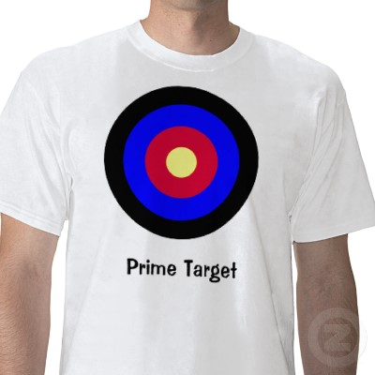
9 teaching tips
# 3
The moving target
Understand you are an easy target
. . . so move around.
Ray’s Teaching tips for dummies

Slide 39

9 teaching tips
# 4
More than intentions
Just being caring, enthusiastic and young doesn't mean a thing
. . . on their own.
Ray’s Teaching tips for dummies

Slide 40
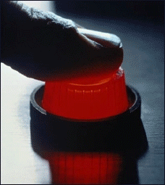
9 teaching tips
# 5
Button pushing
Kids like to press buttons
. . . and you are the biggest one around.
Ray’s Teaching tips for dummies

Slide 41


9 teaching tips
# 6
More poker than pedagogy
Managing student learning is just as much a mix of theatre and poker as knowledge and skills
. . . know when to hold them and know when to fold them.
It’s largely bluff and dare.
Ray’s Teaching tips for dummies

Slide 42

9 teaching tips
# 7
Use your instincts
Use your instincts and intuition
. . . by the time you know what students are up to it is already too late.
Ray’s Teaching tips for dummies

Slide 43

9 teaching tips
# 8
Keep cool
At all costs keep your cool.
. . . and learn how to find it when it gets lost..
Ray’s Teaching tips for dummies

Slide 44
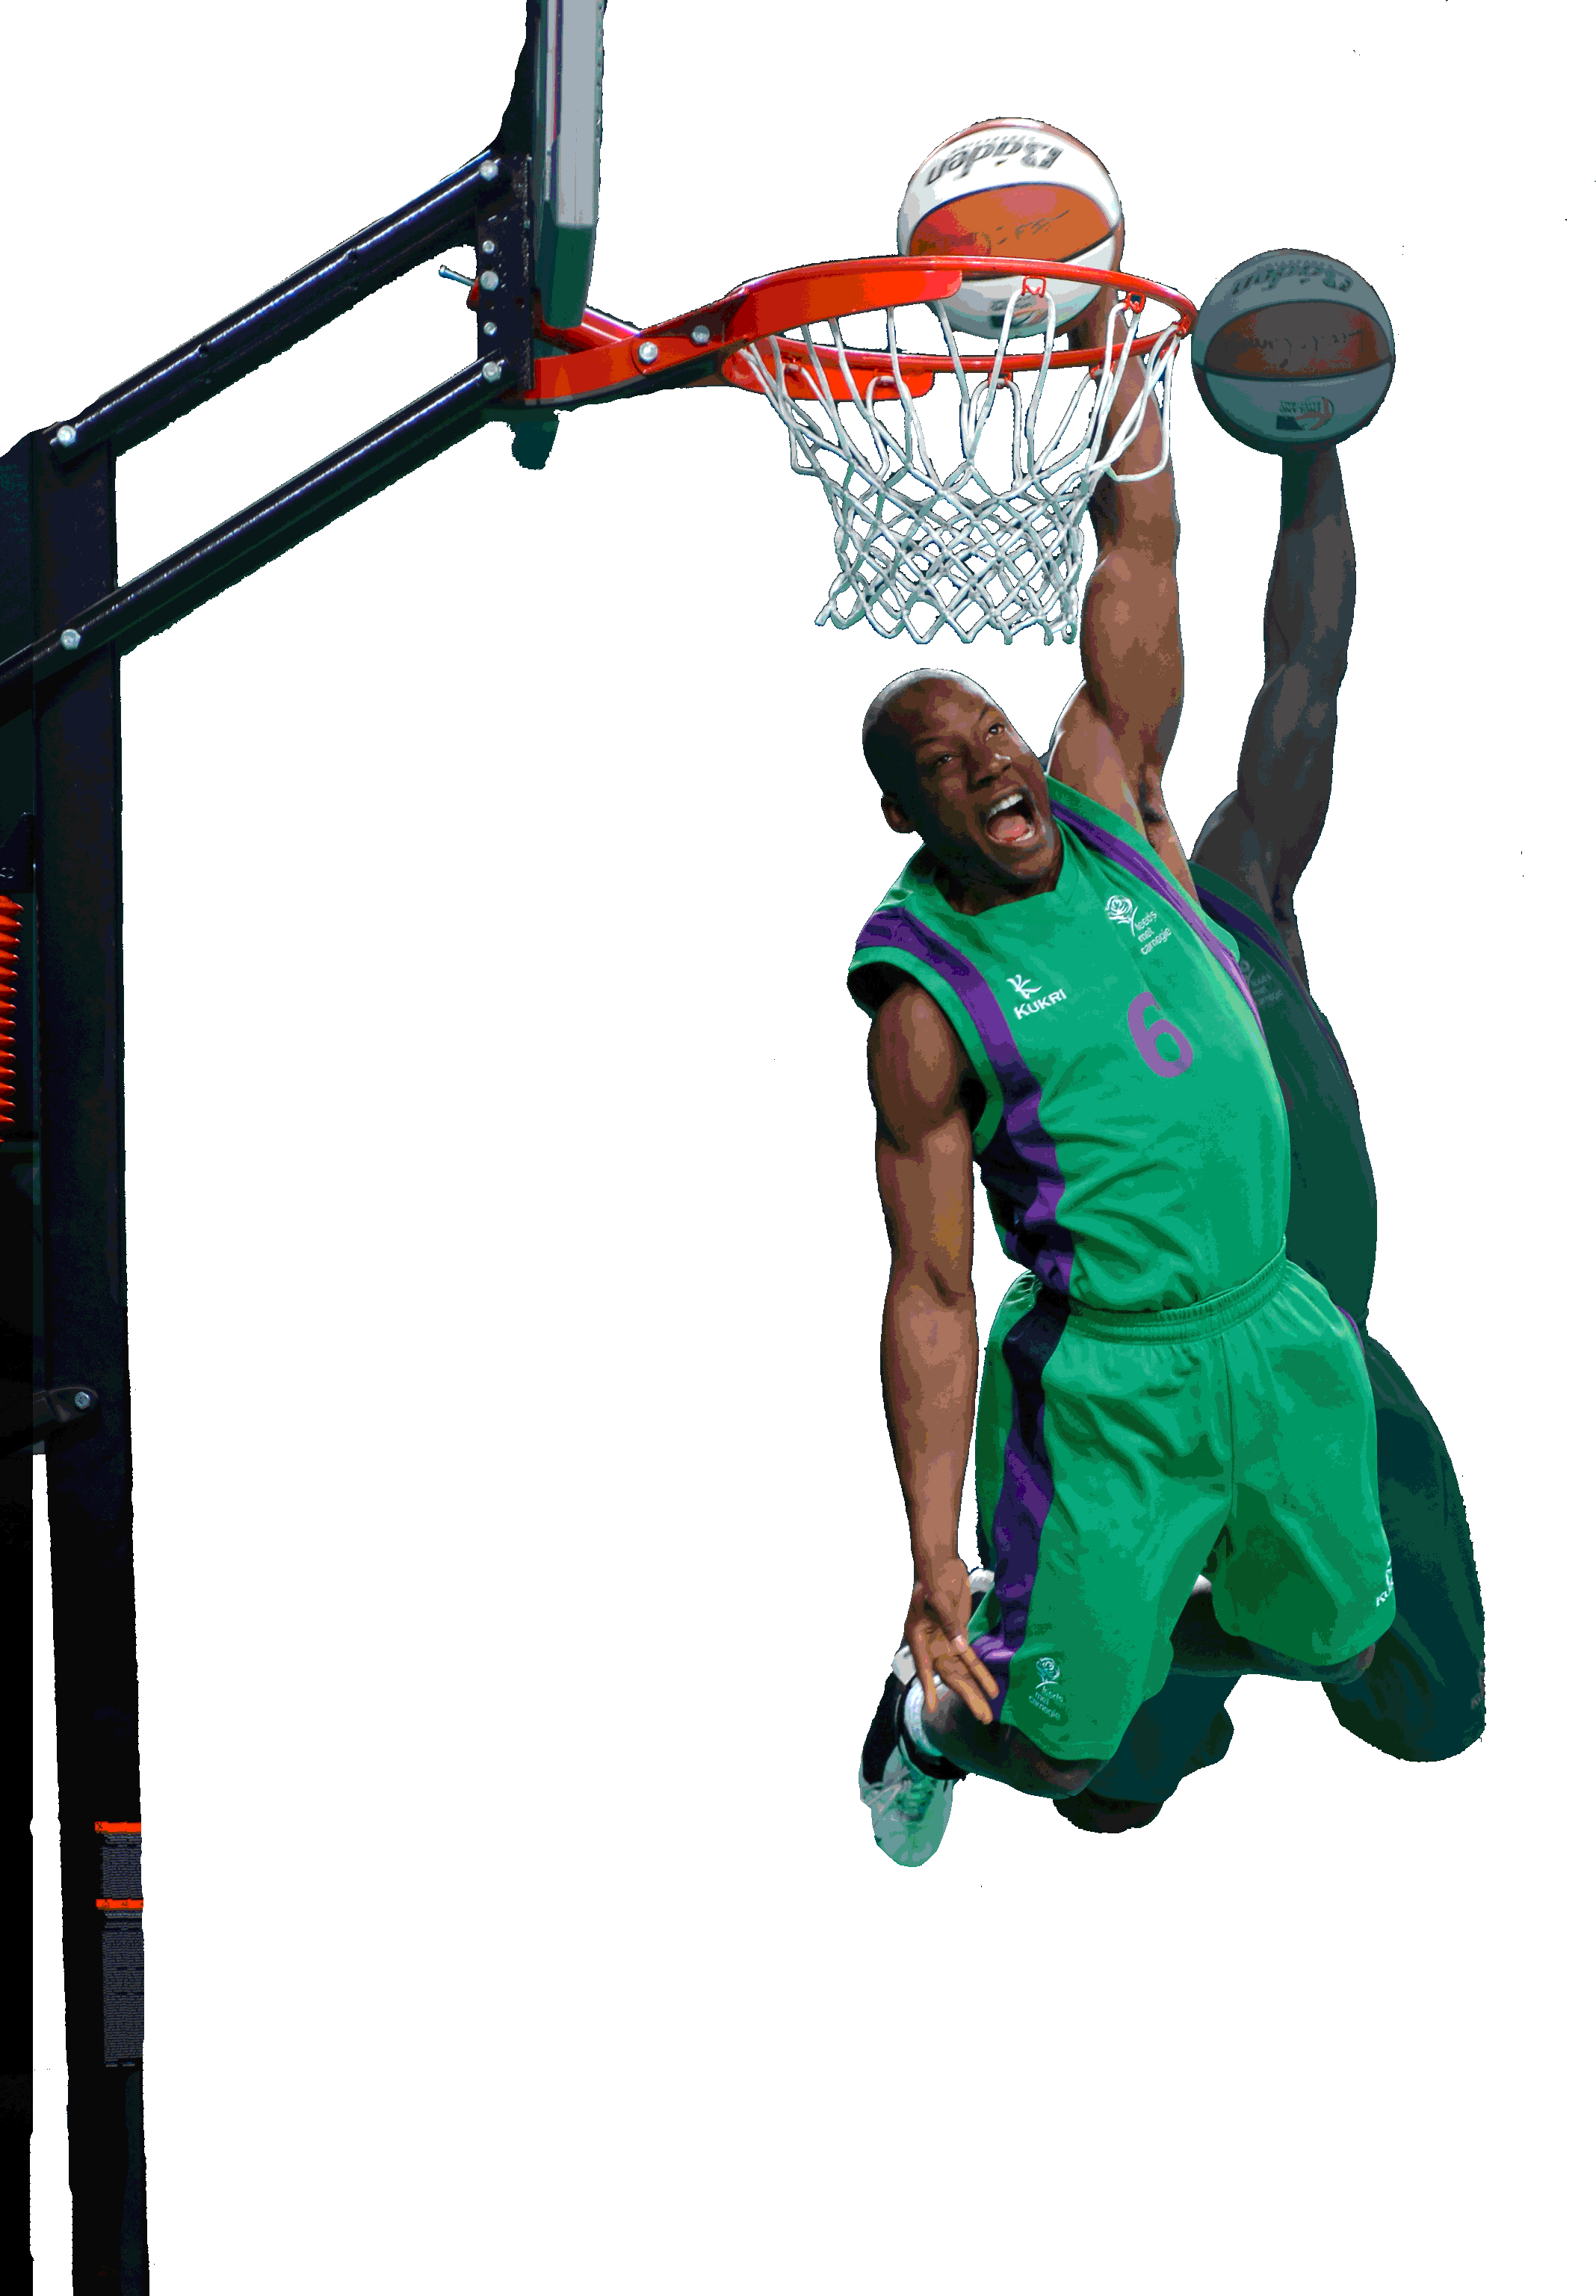
9 teaching tips
# 9
Chunk/funk/dunk
Work needs to be
. . . clearly presented in do-able chunks, interesting and engaging, and leave students with a sense of accomplishment.
Ray’s Teaching tips for dummies

Slide 45
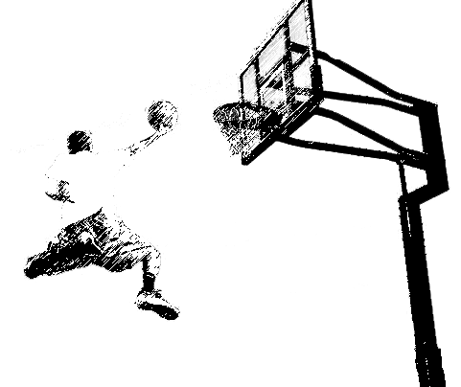
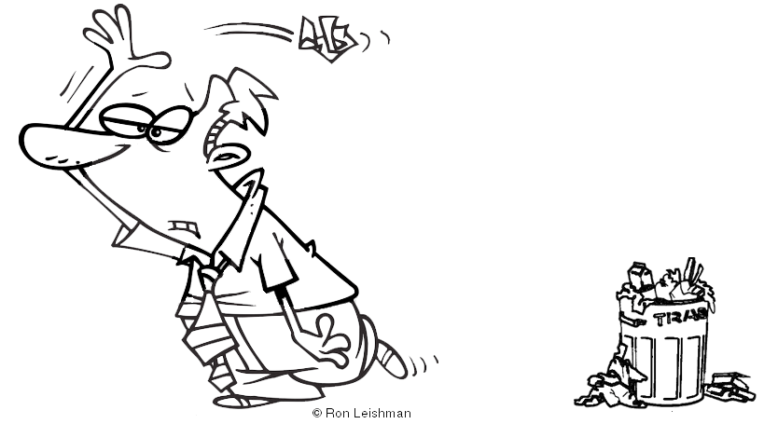
9 teaching tips
# 9
Chuck/fuck/duck
Chunk/funk/dunk
Work needs to be
. . . clearly presented in do-able chunks, interesting and engaging, and leave students with a sense of accomplishment.
Ray’s Teaching tips for dummies

Slide 46

Follow these tips and your teaching will be
. . . fun and relaxing, challenging and rewarding, and exciting and unpredictable
. . . often with only moments between each experience.
Ray’s Teaching tips for dummies

