Slide 1

EDGD801
Learning and behaviour
Behaviour management strategies
Lecture 4
Behaviourist models – Canter
April 7
Presented by Ray Handley

Slide 2
This week
Behaviourist approaches
Assertive Discipline
A classroom model

Slide 3




Bill Rogers
Decisive Discipline
Jacob Kounin
Group Management
Humanism
Ginott/Rogers
Fred Jones
Positive Discipline
Neo-Adlerian
Balson/Dreikurs
Systems Theory
Solution focussed
Applied Behaviour
Analysis
Behaviour Modification
Choice Theory
William Glasser
Canter & Canter
Assertive Discipline
Cognitive-behaviourism
Models of Behaviour Management Continuum
Student empowered
Internal motivation
Autocratic
Limit Setting
Laissez-faire
Non-directive
Teacher empowered
External motivation
Democratic
Leadership

Slide 4
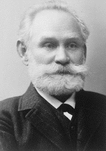

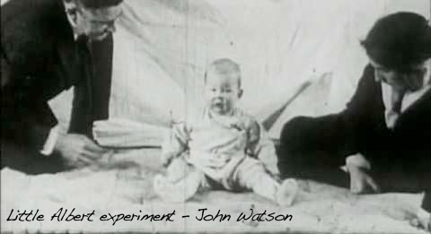
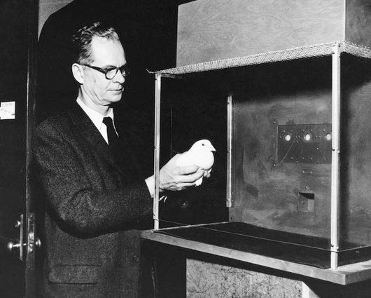
punishment
response
environment
schedules
negative
conditioning
rewards
Behaviourist approaches
external
observable
consequences
systemmatic
stimulus
positive
reinforcement

Slide 5
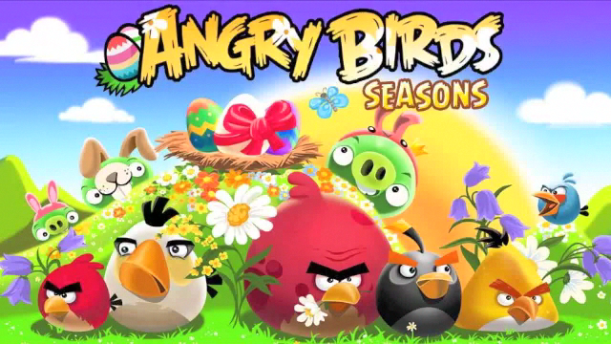
Behaviourist approaches
7 things games teach us about learning:
Measure progress
Multiple short and long term goals
Reward effort
Rapid, clear feedback
Uncertainty
Increases attentiveness and memory
Interaction with others
Chatfield 2010
digital video games

Slide 6

Assertive Discipline – Canter & Canter
Teachers have the right to determine what is best for your students, and to expect compliance.
No pupil should prevent you from teaching, or keep another student from learning.
Student compliance is imperative in creating and maintaining an effective and efficient learning environment.
To accomplish this goal, teachers must react assertively, as opposed to aggressively or non assertively.

Slide 7
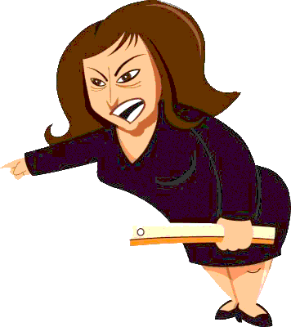
Hostile Teachers
see students as adversaries
use an abrasive, sarcastic and hostile style
focus on the person not on the behaviour
meet their own needs but disregard the needs of the students

Slide 8
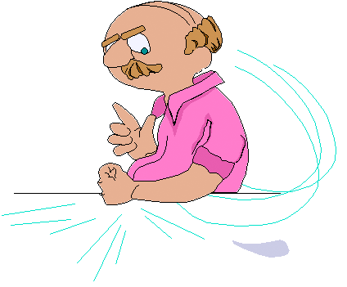
Non-assertive Teachers
ignore or react in desperation
use a passive, inconsistent, timid and non-directive manner
do not communicate their needs to the students
show an uncertainty and fear of the students

Slide 9
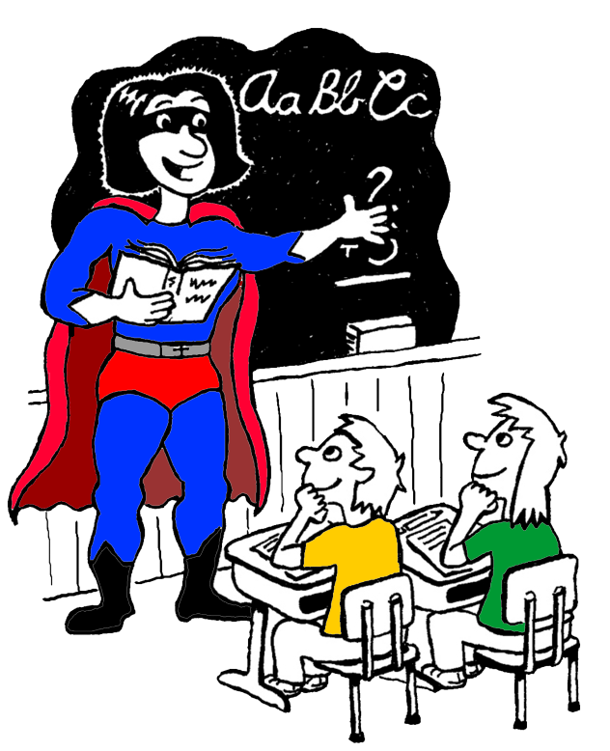
Assertive Teachers
respond confidently, politely and quickly
give firm, clear, concise directions to students
build positive, trusting relationships
are demanding, yet warm in interaction
listen carefully to what their students have to say, and treat everyone fairly (not necessarily equally).

Slide 10
Assertive Discipline – Canter & Canter
features
Clear set of observable, class negotiated rules. Only 3 - 5 max.
For behaviour that breaks the rules a clear, pre-determined set of consequences are laid out.
Focus on positive behaviour with constant reinforcement through comments and recording of compliance.
All students are targeted for both positive recognition and negative consequences when relevant.

Slide 11



CLASS RULES
No talking when the teacher is talking
Stay in your seats
Keep your hands and feet off other people and their property
Follow the instructions given by the teacher
CLASS CONSEQUENCES
1st incident name on board - 1st warning
2nd incident tick - 2nd warning
3rd incident tick - 3rd warning
4th incident tick - stay back after class
5th incident tick - lunch time detention
6th incident tick - leave the class, interview with HT/AP
CLASS RULES
No talking when the teacher is talking
Stay in your seats
Keep your hands and feet off other people and their property
Follow the instructions given by the teacher
CONSEQUENCES
1st name on board - 1st warning
2nd tick - 2nd warning
3rd tick - 3rd warning
4th tick - stay back after class
5th tick - lunch time detention
6th tick - leave the class, interview with HT/ AP

Slide 12


CLASS RULES
No talking when the teacher is talking
Stay in your seats
Keep your hands and feet off other people and their property
Follow the instructions given by the teacher
Caleb



Fabio

Suzie
Jack

Bashir

Shannon
Is it worth it?
Carly



CONSEQUENCES
1st name on board - 1st warning
2nd tick - 2nd warning
3rd tick - 3rd warning
4th tick - stay back after class
5th tick - lunch time detention
6th tick - leave the class, interview with HT/AP
Jess
Ryan




Hassan

Tamika
Lucas

Slide 13

Common pitfalls with Assertive Discipline
Students will not stop behaviours and often will be pushed to get more ticks as a challenge or act of revenge
Ticks are delivered as punishment/consequences not cues/signals
The list of students will be selective rather than inclusive
Ticks are delivered only to certain students in the class
No evidence of a ripple effect
Positive comments to compliant students are not used enough or they are insincere
Little dilemma for students to change
Appropriate positive consequences are not in place

Slide 14
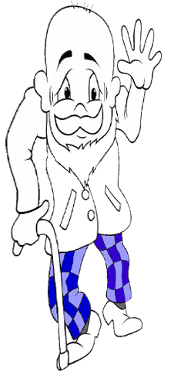
REFERENCES
Canter, L. & (1976) Assertive discipline – a take charge
Canter, M. approach for today’s educator. Santa Monica, CA: Lee Canter & Associates Press
Woolfolk, A. & (2010) Educational psychology (2nd ed). French’s Margetts, K. Forest, NSW: Pearson p 228 - 260

Slide 15
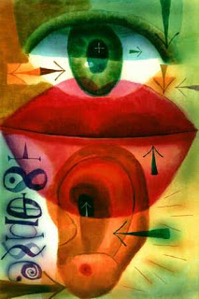
Reflective or empathic listening skills
Some key principles:
More listening than talking
Trying to understand the feelings contained in what the other is saying, not just the facts or ideas.
Responding with acceptance and empathy, not with indifference, cold objectivity or fake concern.
Restating and clarifying what the other has said, not asking questions or telling what the listener feels, believes or wants.
Responding to what is personal rather than to what is impersonal, distant or abstract.
Sensing of the other's frame of reference while avoiding the temptation to respond from the listener's frame of reference.

Slide 16
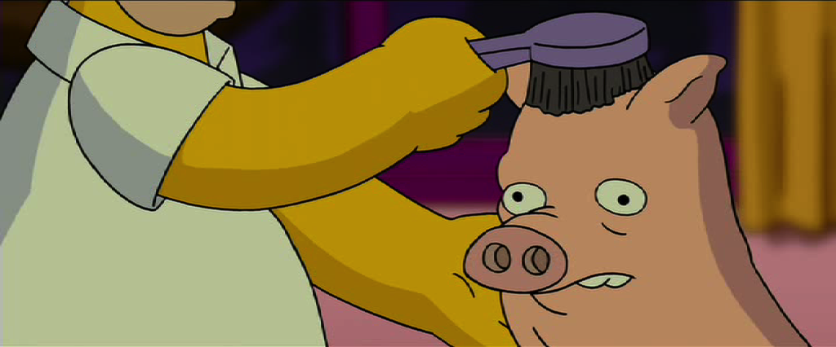
An example of these skills from some experts in student behaviour

Slide 17
Reflective or empathic listening skills
A simple script:
What happened?
Can you tell me what happened?
Intro
You feel angry when . . . .
So you are angry/frustrated/disappointed that . . . .
You think it is unfair when . . . .
It seems like you are being picked on . . .
Reflective
listening
So let me see if I have it right. So you are angry that . . . . . . and frustrated with . . . . . . . And when this happens
  . . . . . . . . . . . . . . . . . . . . . . . . . . . . . . . . . . . . . . . . . . . . . . . . . . . . . . . . . . . . . . . . . . . . . . . . . . . . . .
Influential
summary
(the issue in your words from what you have understood while listening to the other person)

Slide 18

A simple example

Slide 19
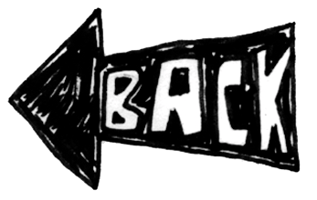
CLASS RULES
No talking when the teacher is talking
Stay in your seats
Keep your hands & feet off other people and their property
Follow the instructions given by the teacher

Slide 20
1st incident name on board - 1st warning
2nd incident tick - 2nd warning
3rd incident tick - stay back after class
4th incident tick - lunch time detention
5th incident tick - leave the class, interview with head teacher/AP
CLASS CONSEQUENCES
1st incident name on board - 1st warning
2nd incident tick - 2nd warning
4th incident tick - stay back after class
5th incident tick - lunch time detention
6th incident tick - leave the class, interview with head teacher/AP
3rd incident tick - 3rd warning

Slide 21
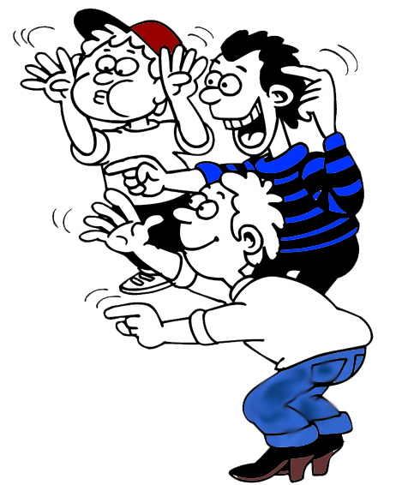
Rewards and motivation
Alfie Kohn http://naggum.no/motivation.html (3 of 5)5/07/2005
Studies Find Reward Often No Motivator
An elderly man, harassed by the taunts of neighbourhood children, finally devises a scheme. He offered to pay each child a dollar if they would all return Tuesday and yell their insults again. They did so eagerly and received the money, but he told them he could only pay 25 cents on Wednesday. When they returned, insulted him again and collected their quarters, he informed them that Thursday's rate would be just a penny. "Forget it," they said – and never taunted him again.
In this story, the sly old man successfully turned the kids away from their favourite after-school activity - senior citizen baiting - by first incentivising the process, and then gradually diminishing the rewards. What had, for the kids, originally been a fun and intrinsically motivating became something they were now doing for extrinsic, monetary gain. When the cash stopped, so did they.
The question that begs to be answered here is, “What actually neutralised the children’s motivation – the incremental reduction of the prize, or the fact that a prize (any prize) had been introduced at all"

