Slide 1
EDGD801
Learning and behaviour
Behaviour management strategies
Lecture 7 – Glasser ‘s Choice Theory and Quality Schools
May 5
Presented by Ray Handley

Slide 2
Overview of this week
Glasser on education
Choice Theory
Quality schools
Changing paradigms – Ken Robinson
Presented by Ray Handley
Notes:
2

Slide 3
Bill Rogers
Decisive Discipline
Humanism
Ginott/Rogers
Jacob Kounin
Group Management
Fred Jones
Positive Discipline
Neo-Adlerian
Balson/Dreikurs
Systems Theory
Solution focussed
Applied Behaviour
Analysis
Behaviour Modification
Choice Theory
William Glasser
Canter & Canter
Assertive Discipline
Cognitive-behaviourism
Models of Behaviour Management Continuum
Student empowered
Internal motivation
Autocratic
Limit Setting
Laissez-faire
Non-directive
Teacher empowered
External motivation
Democratic
Leadership

Slide 4
Quotes
. . . on behaviour change
What we have to understand is that the only life we can control is our own and, in almost all instances, we can choose to change.
Good or bad, everything we do is our best choice at that moment.
It is almost impossible for anyone, even the most ineffective among us, to continue to choose misery after becoming aware that it is a choice

Slide 5
Quotes
. . . on behaviour change
Never let anyone control you with the pain and misery he or she chooses.
What happened in the past that was painful has a great deal to do with what we are today, but revisiting this painful past can contribute little or nothing to what we need to do now.
The brain physiology associated with depressing is no more its cause than sweating is the cause of running.

Slide 6
Quotes
. . . on Quality Schools
There are only two places in the world where time takes precedence over the job to be done. School and prison.
The difference between school and life? In school, you're taught a lesson and then given a test. In life, you're given a test that teaches you a lesson.
To counter the avoidance of intellectual challenge and responsibility, we must reduce the domination of certainty in education.

Slide 7
After the results of a maths test were returned a student approached the teacher and asked why a particular answer was marked incorrect. The question concerned the best value from several options on the price of
flour. The options were:
a) 1kg bag for $1.50
b) 5 kg bag for $6.00 or
c) 10 kg bag for $10.00
The teacher explained that c) was the best value as the flour only cost $1 per kg as opposed to $1.20 per kg in for the 5kg bag and $1.50 for the 1kg bag.
The student then politely corrected the teacher and explained that in their household they did not use much flour and a 10kg bag would only end up being thrown out when the weevils got into it or it went mouldy. So a 1kg bag would be the best value for their situation.
The teacher gave the student the mark for that question.

Slide 8
East Asian countries

Slide 9
East Asian countries

Slide 10
What is takes to score well – an example from China
“Since my daughter began 7th grade, she has had extra evening classes. At that time, the class ends at 6:50pm and I accepted it. But ever since she entered 9th grade, the evening class has lengthened to 8:40pm.
For the graduating class, the students have to take classes from 7:30am to 8:00pm on Saturdays. There are also five weeks of classes during the winter and summer school vacation…
After coming home after 10pm, she has to spend at least one hour on her homework. She has to get up at 5am. She is still a child. May I ask how many adults can endure this kind of work?”
Source - http://news.xinhuanet.com/edu/2010-12/09/c_12863806_3.htm

Slide 11
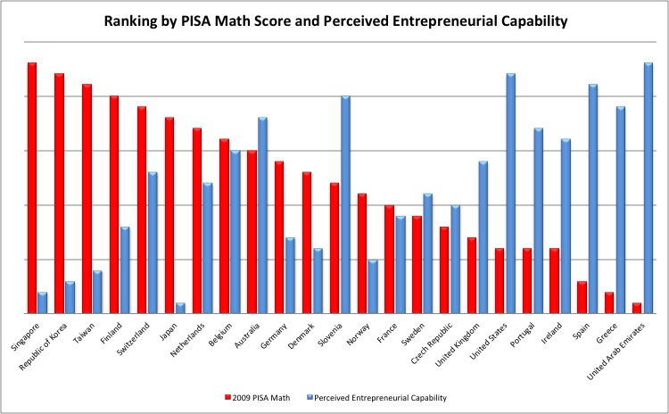
2009 PISA Maths score
Perceived entrepreneurial capacity
% of people confident in their ability for entrepreneurship - Global Entrepreneurship Monitor (GEM)

Slide 12
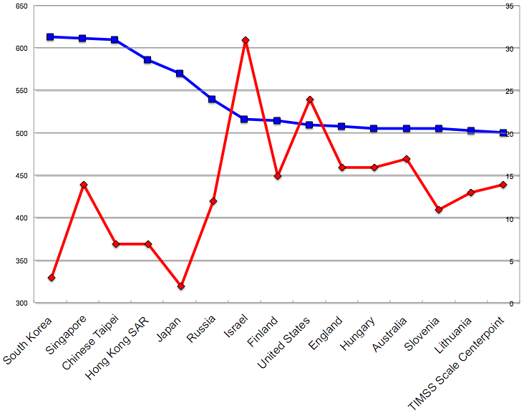
TIMMS (2011) comparison of Year 8 Maths
Trends in international mathematics & science study
Maths score
% confident
Countries

Slide 13
“It has become clear that trying to force students to learn or behave responsibly is hopeless. Schools would do far better if they emphasized three things that have been shown to produce the results we want”
Provide a curriculum that is genuinely attractive to students
Use non-coercive discipline to help students make responsible choices that lead to personal success
Strongly emphasise quality in all aspects of teaching and learning
1
2
3
(Glasser, 2000)
Notes:
Activity
1. What choices do you regularly provide students in your classroom?
2. Would students say that you provide them with opportunities to make choices and decisions?
3. Do you believe that a classroom climate is enhanced when students feel they have some choice?

Slide 14
Quotes
. . . on Quality Schools
Running a school where the students all succeed, even if some students have to help others to make the grade, is good preparation for democracy.
We can pay teachers a hundred thousand dollars a year, and we'll do nothing to improve our schools as long as we keep the A, B, C, D, F grading system.

Slide 15
Quotes
. . . on Quality Schools
In a Glasser Quality School there is no such thing as a closed book test.
Students are told to get out their notes and open their books.
There is no such thing as being forbidden to ask the teacher or another student for help.

Slide 16
Glasser has 6 conditions describing a quality school. These have been reworded below by Hoglund and Lindsey (link)
Quality occurs in a warm, supportive environment
Quality Work is useful.
3. Everyone does their best.
Constant Improvement.
+
5. Quality Work feels good
6. Quality is never destructive.
This is about achieving,
performing, bettering NOT attempting, trying, effort.

Slide 17
Quality occurs in a warm, supportive environment
Continually focus and work on having a positive, supporting, trusting classroom and school environment.
This condition is one of the most difficult tasks to accomplish. To create the type of environment that is described requires individuals and groups to align perceptions and expectations.
It also requires a commitment to working hard toward accomplishing this goal.

Slide 18
Quality occurs in a warm, supportive environment
Reality Therapy is a method of working with others that is consistent with Choice Theory and essential for creating this environment.
When used consistently, these questions have been proven to increase responsibility, and ultimately - happiness!
Want What do you want?
Doing What are you doing?
Evaluate Is it working? (helping / hurting?)
Plan What else can / will you do?.

Slide 19
Choice Theory (Glasser)
Our behaviour is directed at meeting our basic needs:
Students can be focused on being aware of their behaviour and how best it can meet their needs.

Slide 20
2. Quality Work is useful.
Everyone should be asked to do useful work.
This applies even beyond the work that students are asked to do in class. It applies to the expectations and requirements of district and school administration, certified and classified personnel.
Educators are continually challenged to determine what is and what is not worth learning.

Slide 21
2. Quality Work is useful.
Everyone should be asked to do useful work.
While some of the challenges are attempts to avoid work by students and/or faculties, many of the questions and their underlying premises are valid.
Some of the questions are:
· What is useful? · How will it be useful? · What is important? · What do you (the teacher/administrator) see as useful? Why?

Slide 22
Everyone does their best.
Everyone is asked to give their best effort.
The concept of doing one's best is confusing at times. The problem arises because there are two distinct and different uses of the word "best”. We propose that "best" does not always equate to quality.
"Best" as defined in the conditions of quality means more than first effort. It implies the evaluation and revision of work, depth of knowledge and the realisation of its usefulness to the learner.

Slide 23
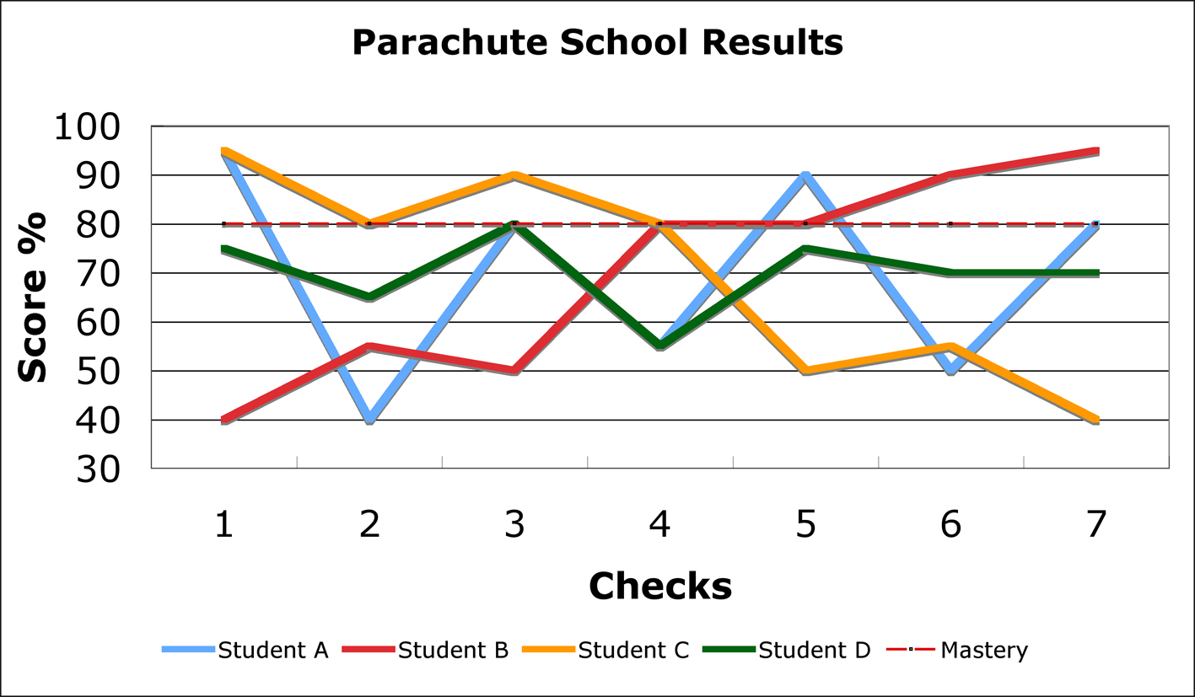
PARACHUTE SCHOOL QUALITY CHECK RESULTS
This example using results from a parachute school course that teaches how to fold parachutes illustrates the significance of mastery learning and highlights many of the inadequacies of our assessment systems.
In this school students learn to fold parachutes for 7 weeks. Each week is assessed and a score given. The graph shows the results for 5 students over the 7 weeks.
Students A, B, C and D all averaged around 70% for the course. Student E --- averaged 80%. Have a look at the patterns in these results and see which student you would want to be packing your parachute.
Explaining this example

Slide 24
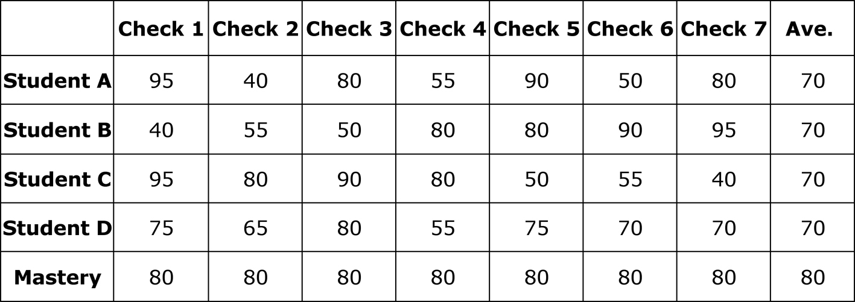
Student E
Ave. score 80%

Ave score 62%

Slide 25
4. Constant Improvement.
Ask everyone to evaluate and improve their own work when it is important to do so.
One of the most valuable skills that anyone can have is the ability to evaluate their own work and effort and continue to improve whatever they are doing.
While students are not the sole evaluators of all of their work, it is important to help them learn what quality work is, how they can best achieve it and how to evaluate their progress along the way.

Slide 26
5. Quality Work feels good
6. Quality is never destructive.
These indicate the degree of quality work that we do. In addition, these points assess how well the other four conditions have been met.
Assessment of quality work may be as simple as the positive feelings that one experiences prior to, during or upon completing goals, tasks, work, etc.
Notes:
By destructive it means that a quality school does not disadvantage learners or create problems for them. In quality schools students perform better on standardised tests than other schools as student demonstrate their competence in whatever tasks is given.

Slide 27
The role of the teacher in a Quality School
Glasser looks at the role of the teacher in
2 ways:
Communication style
Leadership style
Notes:
By destructive it means that a quality school does not disadvantage learners or create problems for them. In quality schools students perform better on standardised tests than other schools as student demonstrate their competence in whatever tasks is given.

Slide 28
The role of the teacher in a Quality School
Communication style
7 caring habits
Supporting
Encouraging
Listening
Accepting
5) Trusting
Respecting
Negotiating differences
7 deadly habits
Criticising
Blaming
3) Complaining
4) Nagging
5) Threatening
6) Punishing
7) Bribing or rewarding to control
Notes:
By destructive it means that a quality school does not disadvantage learners or create problems for them. In quality schools students perform better on standardised tests than other schools as student demonstrate their competence in whatever tasks is given.

Slide 29
The role of the teacher in a Quality School
2. Leadership style
Boss managers:
Set tasks and standards without consultation
Tell rather than show
Designate, inspect, grade
Use coercion
Lead Managers:
Engage workers in discussion of work
Show or model the job
Ask workers to evaluate their own work
Facilitate rather than coerce
Notes:
By destructive it means that a quality school does not disadvantage learners or create problems for them. In quality schools students perform better on standardised tests than other schools as student demonstrate their competence in whatever tasks is given.

Slide 30
from Changing Paradigms – Ken Robinson
http://www.ted.com/talks/ken_robinson_changing_education_paradigms.html

Slide 31
Creativity, diversity
and the changing needs of education
Ken Robinson

Slide 32
References
Hoglund, R. & Lindsey, E. (undated) Condition of Quality. Website. Accessed 1/4/2011 http://www.bobhoglund.com/conditions.htm
Nelson, T.G. (2002) An interview with William Glasser. Website accessed 1/4/2011 http://findarticles.com/p/articles/mi_qa3960/is_200207/ai_n9097918/
Wubbolding, Robert E. 1,2 (2007) Group Dynamics: Theory, Research, & Practice. Special Issue: Groups in Educational Settings. 11(4):253-261, December.
Glasser, W. (1969 – 2007) Various titles - Bibliography
Glasser Institute – North East Region Quotes by Dr. Glasser Website accessed 25/04/2011 http://www.glassernortheast.com/index.php?option=com_content&task=view&id=58&Itemid=107
Glasser, W. (2000) School violence from the perspective of William Glasser. Professional School Counseling, Special Issue: School Violence and Counselors, 4, pp. 77–80.

