Slide 1
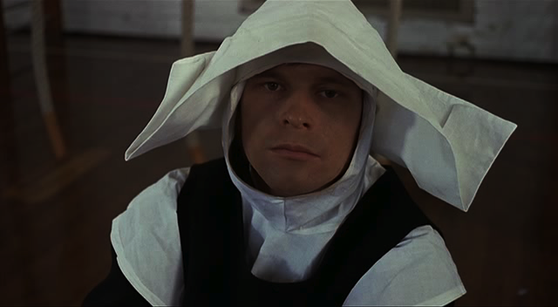
NCI Training 2012

Slide 2


NONVIOLENT CRISIS INTERVENTION
Preventive Intervention
Nonviolent Physical Crisis Intervention
Postvention
Notes:
Click to highlight areas to be covered in this presentation

Slide 3
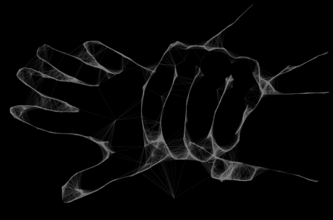
Restraint use
“Any decision taken by staff to physically
restrain a student should be exercised only
in those circumstances where there is a threat of injury to a person
or serious damage to property and there is
of preventing the
likely injury or damage.”
real and immediate
no other practical way
When can restraints be used by teachers?
DET Legal Issues Bulletin No.9
skip

Slide 4
Risk management
Risk Management and Functional Assessment
Under the Occupational Health and Safety Act 2000 …an employer must provide all available information necessary to enable relevant employees to fulfil their responsibilities with respect to:
identifying hazards
assessing risks arising from those hazards
eliminating or controlling those risks
monitoring and reviewing the risk control measures
providing information to others
FBA

Slide 5
Purpose of NCI
The Purpose of
Nonviolent Crisis Intervention
To provide the . . .
WELFARE
CARE
supporting emotional & physical well-being
showing compassion & empathy
SECURITY
SAFETY
ensuring harmony – not harm
preventing danger, risk & injury
. . . for all those who are involved in a crisis situation
Notes:
Just an amusing look at how intervention can go wrong if factors are ill considered or ignored.

Slide 6
Crisis development model 1
The Crisis Development Model
Unit 1
Crisis development/behaviour levels
Staff attitudes/Approaches
1.
Anxiety
Supportive
2.
Defensive
An empathic, non-judgemental approach attempting to alleviate anxiety
3.
Acting out person
A noticeable increase or change in behaviour eg pacing, finger tapping, staring, wringing hands
4.
Tension reduction
Notes:
It will be easier to identify anxious behaviour in those people you know well because the changes from normal will be more apparent. Building relationships with those in your care is a great asset in identifying anxiety and therefore intervening early.

Slide 7
CDM - Defensive
The Crisis Development Model
Crisis development/behaviour levels
Staff attitudes/Approaches
1.
Anxiety
Supportive
2.
Defensive
Directive
3.
An approach in which a staff member takes control of a potentially escalating situation by setting limits
The beginning stage of loss of rationality. At this stage, an individual often becomes belligerent & challenges authority
4.
Notes:
It will be easier to identify anxious behaviour in those people you know well because the changes from normal will be more apparent. Building relationships with those in your care is a great asset in identifying anxiety and therefore intervening early.

Slide 8
CDM - Acting out
The Crisis Development Model
Crisis development/behaviour levels
Staff attitudes/Approaches
1.
Anxiety
Supportive
2.
Defensive
Directive
3.
Acting out person
Nonviolent physical crisis intervention
Safe, non-harmful control and restraint positions to safely control an individual until he can regain control of his behaviour. These techniques should be utilised as a last resort, when an individual presents a danger to self or others.
4.
The total loss of control which results in a physical acting-out episode
Notes:
Nonviolent physical Crisis Intervention is an emergency procedure used only when the potential danger of intervening is surpassed by the imminent danger of the crisis moment.

Slide 9
CDM - Therapport
The Crisis Development Model
exp
integrated
erience
Crisis development/behaviour levels
Staff attitudes/Approaches
An approach used to re-establish communication with an individual who is experiencing Tension Reduction. Builds relationships with individual after a crisis.
1.
Anxiety
A decrease in physical and emotional energy that occurs after a person has acted out, characterised by the regaining of rationality
Supportive
2.
Defensive
Directive
3.
Acting out person
Nonviolent physical crisis intervention
4.
Tension reduction
Therapeutic rapport
Reasons for using the Crisis development Model
helps us to intervene early and appropriately
helps us to avoid overreacting or under-reacting
helps us to avert a crisis
Notes:
Integrated experience is inserted here to introduce an awareness that the behaviour of clients and the actions of staff affect or feedback to each other.

Slide 10

The crisis model
THE CRISIS CYCLE
Integrated experience
Intervention ownership
anxiety
External control
Staff actions
reduction
tension
defensive
Internal control
Client actions
acting
out
preventive
corrective
restorative
Notes:
This is just an additional model not covered in the CPI notes and manual. It highlights the difference level of staff involvement or action depending of the position on the crisis cycle. When nonviolent physical intervention is used the clients loses almost total control over their actions - although this can be quickly changed as they calm down and move with either back to a defensive position or on towards tension reduction.

Slide 11

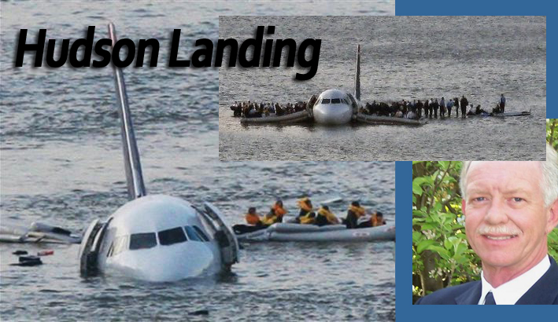
Prepare - Hudson landing
Rehearse, Review, Respond
PREPARE, PLAN, PERFORM

Slide 12
Non-verbal behaviour
Unit 2
NON-VERBAL BEHAVIOUR
1. Proxemics
- Personal space
Generally 1/2 to 1 metre
Kinesics
- Body language
Includes personal items such as backpacks, purse, mobile phone, aids
Affected by other factors such as gender, size, cultural background, familiarity . . . . .
3. Reasons for using the CPI Supportive Stance
Kinesics
- Body language
3. Reasons for using the CPI Supportive Stance
Notes:
Practical exercises need to be used before going into detail on this.
Either use the two line moving towards each other exercise OR
Ask for a suitable volunteer or volunteers and have them demonstrate to the group.
First just have them move to within each others personal space, then one step more.
Next have the person move more quickly and/or with something in there hands, or with a clenched fist.
Finally demonstrate the supportive stance - one leg length away, slightly off to one side and turned into an ‘L’ shape

Slide 13
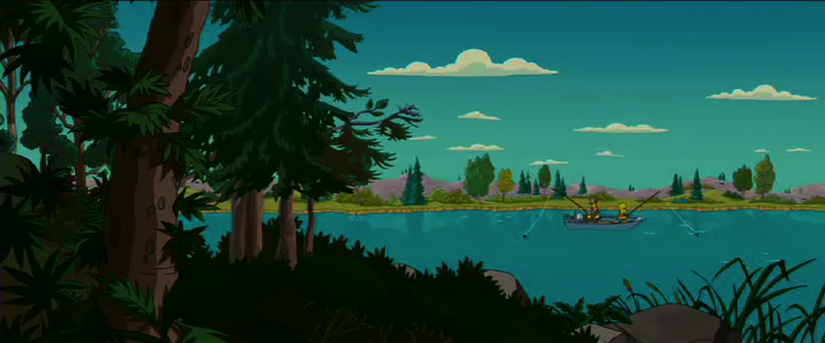
Non-verbal - Proxemics
Unit 2
NON-VERBAL BEHAVIOUR
1. Proxemics
- Personal space
Kinesics
- Body language
Non-verbal message transmitted by the motion and posture of the body
3. Reasons for using the CPI Supportive Stance
Includes include facial expressions, gestures, posture and movements
Can serve to escalate or de-escalate a given situation. A challenging or confrontational body position used when approaching an individual may increase anxiety and make defusing the situation more difficult.
3. Reasons for using the CPI Supportive Stance

Slide 14
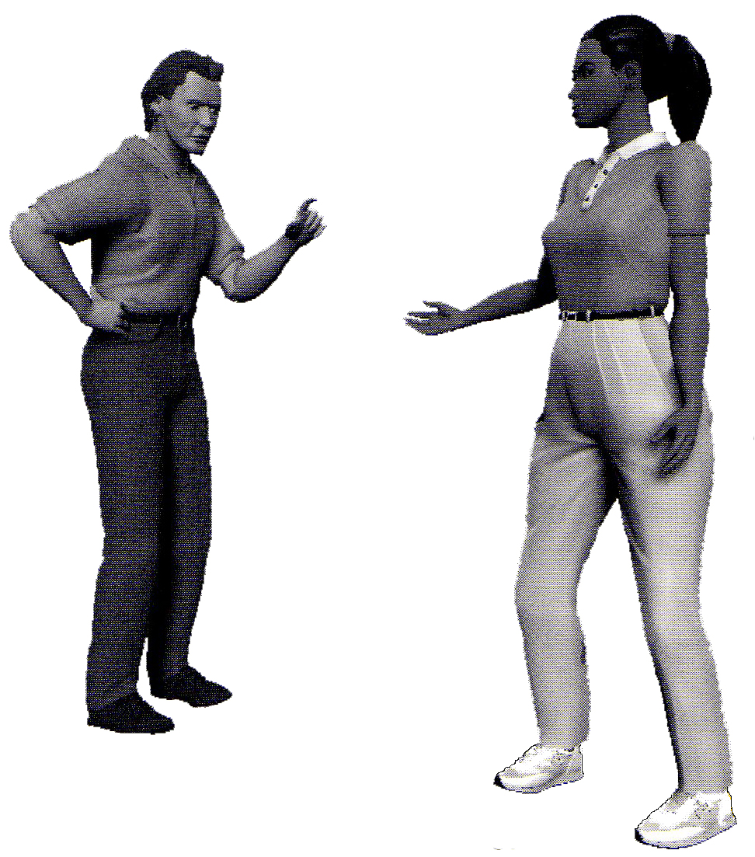
Supportive stance
Unit 2
NON-VERBAL BEHAVIOUR
1. Proxemics
- Personal space
Kinesics
- Body language
3. Reasons for using the CPI Supportive Stance
Communicates respect by honouring personal space
Is non-threatening/non-challenging
At least one leg length away
Slightly off to the side
Positioned in a ‘L’ shape
Contributes to staff’s personal safety if attacked/offers an escape route
Staff

Slide 15
Paraverbal
Unit 3
PARAVERBAL COMMUNICATION
How you say what you say.
Components
Tone - avoid inflections of impatience, frustration, condescension, inattention . . .
Volume - keep the volume appropriate for the distance and the situation
Cadence - use an even rhythm and rate to deliver the message
Staff
Notes:
I didn’t tell the staff you stole the money
or
You know (name), I always wanted a job like yours.

Slide 16
Paraverbal example
Unit 3
PARAVERBAL COMMUNICATION
How you say what you say.
Try this example:
I
didn’t
tell
staff
you
stole
the
money
Staff
Notes:
I didn’t tell the staff you stole the money
or
You know (name), I always wanted a job like yours.

Slide 17
Verbal Escalation kite
Unit 4
VERBAL COMMUNICATION
The CPI Verbal Escalation Continuum
3. Release
defensive
4. Intimidation
2. Refusal
5. Tension reduction
1. Questioning

Slide 18
Questioning
Unit 4
VERBAL COMMUNICATION
The CPI Verbal Escalation Continuum
Rational, valid questions seeking a rational response
1. Questioning
A. Information seeking
B. Challenging
Questioning authority, evasive, drawing others into a power struggle
What are we doing today?
What page are we on?
Where do you want me to sit today?
Where do you want me to go?
Interventions:
What the point of learning this crap?
Who are you to tell me what to do?
Since when do you know how to teach maths?
Why don’t you try and make me leave?
A. Answer the question, give a rational response
B. Avoid, ignore the challenge, redirect back to the issue. Set limits if the individual persists

Slide 19
Refusal - limits
Unit 4
VERBAL COMMUNICATION
The CPI Verbal Escalation Continuum
2. Refusal
Non-compliance, slight loss of rationality
Limits are better received when a positive choice and consequence are stated first.
Interventions:
Set limits
more
Effective limits are:
simple and clear
reasonable
enforceable
Allow some take up time
for the student to decide
Notes:
Set limits box is linked to Larson cartoon looking at transparent limits.

Slide 20
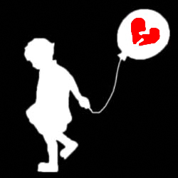

Refusal - Ginott
Unit 4
VERBAL COMMUNICATION
The CPI Verbal Escalation Continuum
2. Refusal
Non-compliance, slight loss of rationality
Some interesting ideas from Haim Ginott
Haim Ginott argued that you can quite easily give a child compassionate emotional support and firm boundaries at the same time. He believed that you could set firm limits on their behaviour, but still respect a child's feelings.
Notes:
Set limits box is linked to Larson cartoon looking at transparent limits.

Slide 21
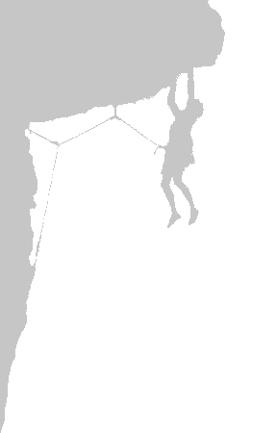
The Tension Model
CONSEQUENCES
an outcome of decisions
Logical
Natural
Imposed
Individual
Reflective
Non-direct
Instructive
Subjective
Skills-based
FEEDBACK
DECISION MAKING
Reflection/cybernetics
taking a position
Uses:
modelling
Mirroring/reframing
narrative
reflection
notices difference
evocative solutions
Uses:
advice giving
lecturing
interrogation
transparent options
making judgements
prescriptive solutions
TENSION
disequilibrium
dissonance
Tension  issue continues
Tension  issue resolved

Slide 22

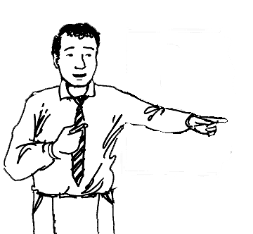
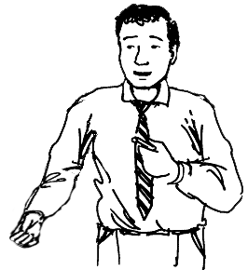
Setting limits
Redirecting the thoughts of students back to their behaviour and
creating a dilemma for them in which a decision or action is needed
Setting a limit is not the same as issuing an ultimatum.
ultimatum
You can finish the work now and go out to lunch with the others or if it is unfinished you will stay back at lunch and I can help you with it. You decide.
If you don’t finish the work you will stay back at lunch.

Slide 23
Limitsetting 2
Setting limits
Limitsetting 1
Redirecting the thoughts of students back to their behaviour and
creating a dilemma for them in which a decision or action is needed
Setting a limit is not the same as issuing an ultimatum.
The purpose of limits is to teach, not to punish.
Through limits, people begin to understand that their actions, positive or negative, result in predictable consequences. By giving such choices and consequences, a structure for good decision making is provided.

Slide 24
Limitsetting 3
Setting limits
Redirecting the thoughts of students back to their behaviour and
creating a dilemma for them in which a decision or action is needed
Setting a limit is not the same as issuing an ultimatum.
The purpose of limits is to teach, not to punish.
Setting limits is more about listening than talking.
By listening, you will learn more about what’s important to students, and that will help you set more meaningful limits.

Slide 25
Limitsetting 5steps 1
Setting limits
Explain which behaviour
is inappropriate
5
Saying ‘Stop that!” may not be enough. The person may not know if you are objecting to how loudly he is talking or objecting to the language that he is using. Be specific.
Steps
More

Slide 26
Limitsetting 5steps 2
Setting limits
Explain which behaviour
is inappropriate
5
Explain why the behaviour is inappropriate.
Steps
Don’t assume the student knows why her behavior is not acceptable. Is she disturbing others? Being disrespectful? Not doing a task she’s been assigned?

Slide 27
Limitsetting 5steps 3
Setting limits
Ultimatums often lead to power struggles because no one wants to be “forced” to so something.
Explain which behaviour
is inappropriate
By providing choices with consequences, you are admitting that you cannot force his decision. But you can determine what the consequences for his choices will be.
5
Explain why the behaviour is inappropriate.
Steps
Give reasonable choices
with consequences.

Slide 28
Limitsetting 5steps 4
Setting limits
Give a few moments for a decision to be made. If upset, the student may not be thinking clearly. It may take her longer to think through what you’ve said.
Explain which behaviour
is inappropriate
5
Explain why the behaviour is inappropriate.
Steps
Allow time.
Give reasonable choices
with consequences.

Slide 29
Limitsetting 5steps 5
Setting limits
It’s important to set consequences that are reasonable, enforceable, within your
Explain which behaviour
is inappropriate
Be prepared to enforce
your consequences.
5
. . . authority, and within the policies and procedures of your facility or school.
Explain why the behaviour is inappropriate.
Steps
Allow time.
Give reasonable choices
with consequences.

Slide 30
Limitsetting 5steps all
Setting limits
Explain which behaviour
is inappropriate
Be prepared to enforce
your consequences.
5
Explain why the behaviour is inappropriate.
Steps
Allow time.
Give reasonable choices
with consequences.
back

Slide 31

Release
Unit 4
VERBAL COMMUNICATION
The CPI Verbal Escalation Continuum
3. Release
Acting out, emotional outburst, loss of rationality, blowing off steam, screaming, swearing, high energy output
Interventions:
Allow them to let off steam
Isolate the situation - remove audience or acting out individual from the area
Maintain eye contact and speak calmly
State non-threatening directives when individual starts to calm down
Notes:
Be ready to move and be prepared to enforce any limits set.

Slide 32
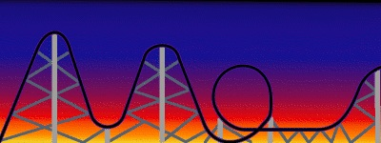
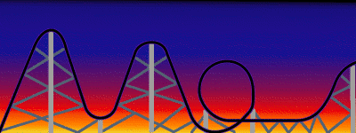
Rollercoaster
Riding the Crisis Rollercoaster
Isolate the situation
Give time to regain control
Remain calm
Restate limits
next stage . . .
a window on behaviour . . .

Slide 33
intimidation
Unit 4
VERBAL COMMUNICATION
The CPI Verbal Escalation Continuum
4. Intimidation
Individual verbally and/or non-verbally threatens staff. A hands-on approach may trigger physical acting-out behaviour
Interventions:
Take threats seriously
Seek assistance and wait for team to intervene
Avoid individual intervention as this puts at risk the safety and welfare of you and the student
Notes:
10% of threats are presented or followed through

Slide 34
Tension reduction
Unit 4
VERBAL COMMUNICATION
The CPI Verbal Escalation Continuum
5. Tension reduction
A drop in energy following a crisis
Interventions:
Re-establish communication
Use the C.O.P.I.N.G. guidelines to develop therapeutic rapport (more . . . .)
Notes:
The C.O.P.I.N.G. Model will be looked at later in the workshop when we cover POSTVENTION.

Slide 35
Verbal dos donts
Unit 4
VERBAL COMMUNICATION
Verbal Intervention Tips and Techniques
Do’s
Don’ts
Stay calm
Overreact
Isolate the situation
Give false promises
Set appropriate limits
Get into a power struggle
Listen (…and watch)
Blame/be judgemental
Pay attention to body language
Threaten
Give space . . . and time
Fake attention
Be consistent
Use jargon
Have a plan

Slide 36
Empathic listening
Unit 4
VERBAL COMMUNICATION
Empathic Listening
An active process to discern what a people are really saying.
It can rapidly defuse crisis situations . . .
. . . and provides the foundation for therapeutic rapport
1. Give undivided attention
2. Be non-judgemental
3. Focus on feelings not just the facts
4. Allow silence for reflection
5. Restate/rephrase the message
5.
more . . .
Notes:
More details on Reflective listening are linked to this page.

Slide 37
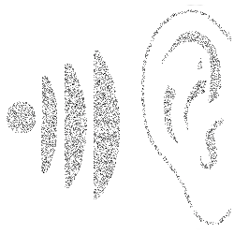
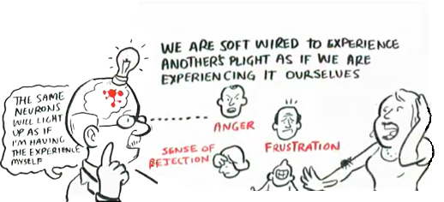
VERBAL COMMUNICATION
Empathic or Reflective Listening
Source: Jeremy Rifkin – TED talk presentation by RSA animations (
Notes:
More details on Reflective listening are linked to this page.

Slide 38


VERBAL COMMUNICATION
Empathic or Reflective Listening
Source: Jeremy Rifkin – TED talk presentation by RSA animations
Notes:
More details on Reflective listening are linked to this page.

Slide 39
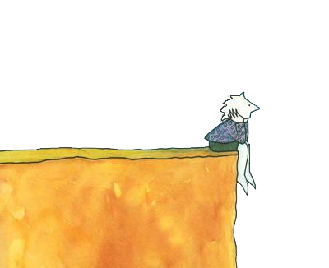
VERBAL COMMUNICATION
Empathic or Reflective Listening Skills
Step 1
Open question – What happened?
Step 2
Listen but don’t hear. Don’t react to what is said just understand the feelings behind it
Step 3
Reflect back the feelings until the heat is gone – around 3 responses
Step 4
Use an influential summary to move into the next phase
Notes:
More details on Reflective listening are linked to this page.

Slide 40
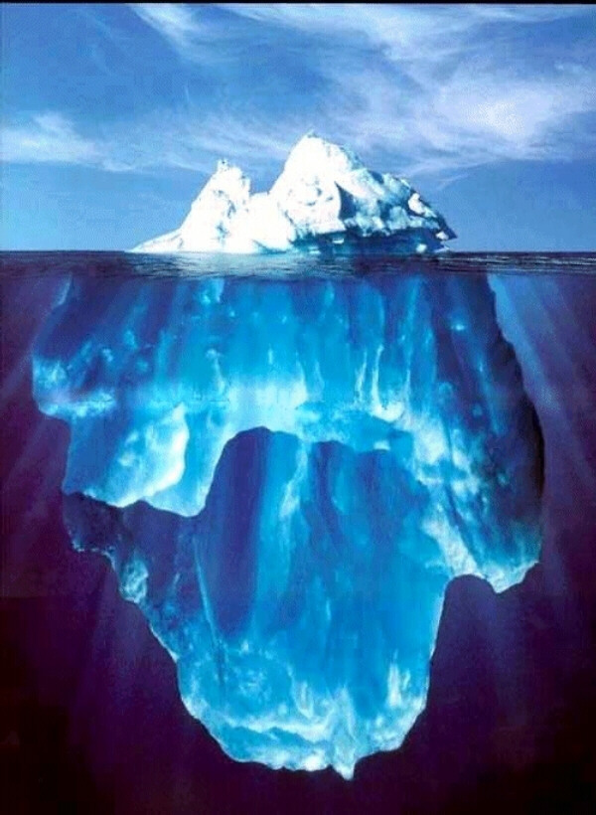


Precipitating
Unit 5
PRECIPITATING FACTORS, RATIONAL DETACHMENT, INTEGRATED EXPERIENCE
Precipitating Factors
Internal or external factors over which staff have little or no control
Examples:
family issues
hunger
rejection
failure
grief
displaced anger
weather
health issues
drugs
fear for safety
disabilities
Notes:
Understanding precipitating behaviours can help staff:
Prevent acting out behaviour
Depersonalise crisis situations by recognising other factors at play beyond our affect
Stop us from becoming part of the problem

Slide 41


Rational Detach
Unit 5
PRECIPITATING FACTORS, RATIONAL DETACHMENT, INTEGRATED EXPERIENCE
Rational Detachment
The ability to stay in control of one’s own behaviour and not take acting out behaviour personally
Can’t control many factors but staff can control their own response to acting out behaviours
Self control is needed to avoid overreacting or acting inappropriately
KEY POINTS
Need to find positive outlets for negative energy absorbed during a crisis
Find your own warning cues and ways to detach at home, at work and in a crisis

Slide 42
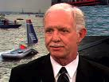

Rational Detach with Sully
Unit 5
PRECIPITATING FACTORS, RATIONAL DETACHMENT, INTEGRATED EXPERIENCE
Rational Detachment
Some questions to consider . . .
How do I know when my line of acceptance is dropping (or when my buttons are being pushed)? [RECOGNITION]
What reminders can I give myself or steps can I take to bring back my self control? [REMINDERS/REMEDIES]
When I am rationally detached do I have a range of strategies to use when difficult situations arise [REPERTOIRE]
What strategies work for me in 'shedding' the negative energy that is absorbed in the classroom while I am maintaining my rational detachment? [RESTORATION]

Slide 43
Integrated model
Unit 5
PRECIPITATING FACTORS, RATIONAL DETACHMENT, INTEGRATED EXPERIENCE
Integrated Experience
Reasons for using the Crisis development Model
helps us to intervene early and appropriately
helps us to avoid overreacting or underreacting
helps us to avert a crisis
The concept that behaviours and attitudes of staff impact behaviours and attitudes of individuals, and vice versa.
exp
The Crisis Development Model
integrated
erience
Crisis development/behaviour levels
Staff attitudes/Approaches
1.
Anxiety
( - )
( + )
Supportive
2.
( - )
( + )
Defensive
Directive
Nonviolent physical
crisis intervention
3.
( - )
( + )
Acting out person
4.
( - )
( + )
Tension reduction
Therapeutic rapport
Notes:
Individuals do not act out in a vacuum. Their behaviour affects staff and vice versa.
If we stay in control when encountering a disruptive individual we can display a positive action which reduces the chance of an escalation in the situation.

Slide 44

Fear Anxiety
Unit 6
STAFF FEAR AND ANXIETY
These are universal human emotions that evoke both a psychological and physiological response
Unproductive
Productive
Freezing
Increase in speed & strength
Overreacting/catastrophising
Increase in sensory acuity
Respond inappropriately
Decrease in reaction time
Keenness or sharpness of perception
- verbally
- physically
Notes:
Ways to control fear and anxiety:
Understand what makes us afraid
Learn techniques to protect ourselves and acting out individuals
Use a team approach - don’t respond alone - Have a plan
Learning physical intervention techniques to manage acting out individuals , if necessary

Slide 45
Controlling fear
Unit 6
STAFF FEAR AND ANXIETY
Ways to control fear and anxiety:
understand what makes us afraid
learn techniques to protect ourselves and acting out individuals in a crisis
use a team approach - don’t respond alone - have a plan
Value of a Team Approach
safety
professionalism
litigation
learn physical intervention techniques to manage acting out individuals, if necessary
Notes:
Ways to control fear and anxiety:
Understand what makes us afraid
Learn techniques to protect ourselves and acting out individuals
Use a team approach - don’t respond alone - Have a plan
Learning physical intervention techniques to manage acting out individuals , if necessary

Slide 46
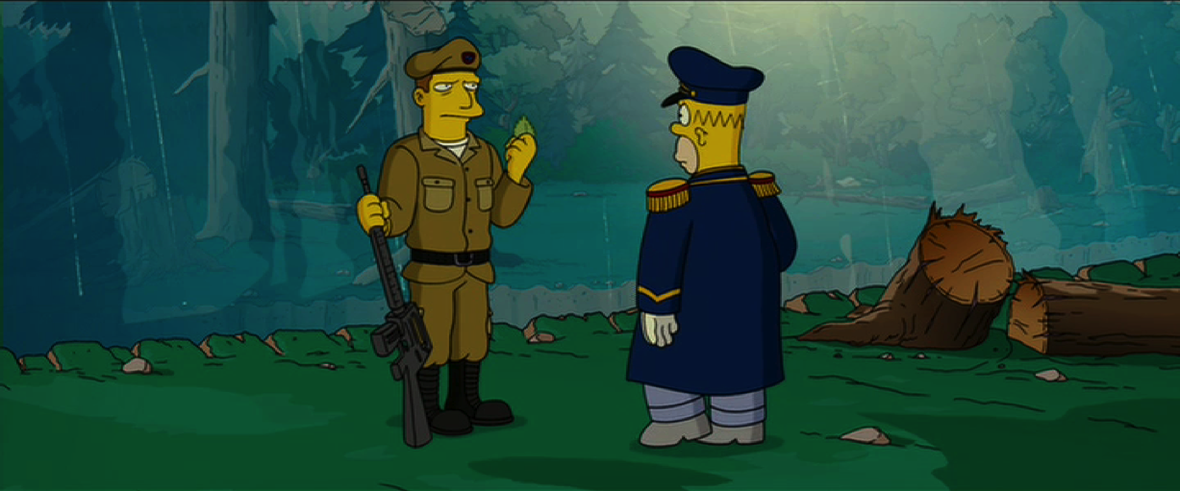
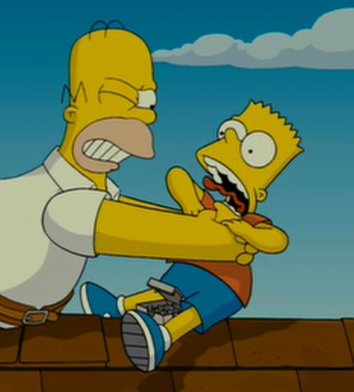
Personal safety
Unit 7
CPI’s Personal Safety Techniques
Definitions:
Strike -
a weapon coming into contact with a target
Grab -
the attempt to control or destroy a part of
one’s anatomy
Every grab starts as a strike
Examples:
Strike
Grab
punch
wrist grab
hit
hair pull
kick
choke
thrown object
bite

Slide 47
Strike grab
Unit 7
CPI’s Principles of Personal Safety
Strike
Grab
1. Block (or deflect) the weapon.
1. Gain a physiological advantage:
a. Find the weak point
b. Use leverage
c. Use momentum (arms, hips, legs)
2. Move the target
2. Gain a psychological advantage:
a. Stay calm
b. Have a plan - options to escape
c. Using an element of surprise or distraction

Slide 48

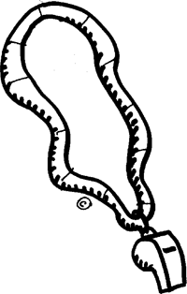



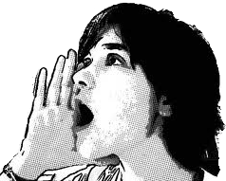
Unit 8
Team intervention
Crisis response team
practiced
coordinated & inconspicuous
communication
2 – 5 members
Team versus solo invention
Safety
Professionalism
Litigation

Slide 49
Unit 8
Team intervention
Team leader
first person on the scene
the person with confidence and competence in handling crises
someone with good rapport with the individual
Duties
assess the situation
plan the intervention
direct and cue the team
communicate with the acting out person (if they are the most suitable person)

Slide 50
Unit 8
Team intervention
Auxiliary team member duties
Check
Address
Recognise
Engage
safety of environment
physical & psychological status of the individual
any safety concerns
support de-escalation
that control dynamics are safely applied
if additional assistance is needed
need to change intervention strategies
in verbal de-escalation (if directed)
in support to other team members

Slide 51
Postvention
Unit 10
POSTVENTION
⁻ The CPI Coping Model
client
staff
C
ontrol
back in emotional & physical control
back in emotional & physical control
O
to the basic facts from their perspective (their story)
to the basic facts from your perspectives
rient
P
in past behaviour and look for triggers
in the way staff and teams respond
atterns
I
alternatives for future behaviour. Ways to do things differently.
nvestigate
ways to strengthen the team response
N
an agreement or contract for future behaviour
changes that need to be made with the team
egotiate
G
responsibility for their behaviour back to them
encouragement and support to team members
ive
more . . .
Notes:
Postvention provides an opportunity to toward change and growth for individuals who have acted out, as well as for staff members. Without a Postvention process such as the one described below, crisis are likely to occur over and over again.

Slide 52
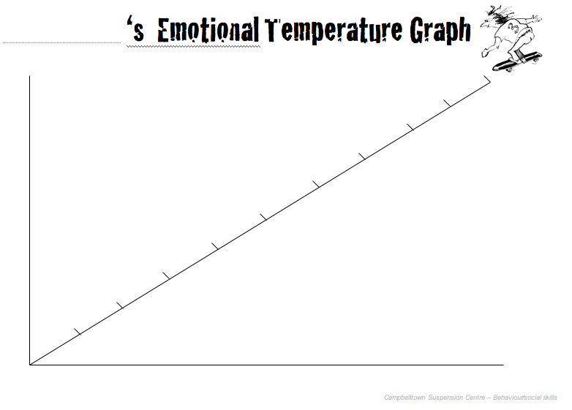
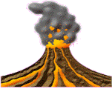
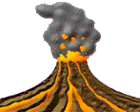
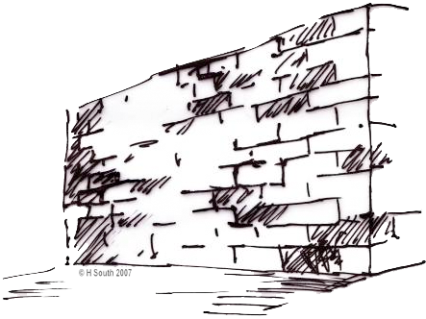
Emotional temp
Anyone
Start fighting and yelling
10
STOP
Think Consequences
Is it worth it?
9
8
Throwing things
Swearing
Hitting out
Walk over and push them
7
6
Push back and call me a wanker
5
Answer back
Out of control
4
Feeling good
3
Keep saying things
Mention my mum
2
Get called names
1
0
In control
tension reduction
back

Slide 53

Crisis review
Reviewing a Crisis Intervention
1. Prevention
What preventative measures are in place that are specific to this situational challenge?
What preventative measures are in place that are specific to this situational challenge?
2. Response
How do staff respond at earlier levels of crisis?
How do staff respond at earlier levels of crisis?
Is there an understanding of how, where and when the challenging behaviour is taking place?
Have patterns of behaviour been identified?
3. Assessment
Is there an understanding of how, where and when the challenging behaviour is taking place?
Have patterns of behaviour been identified?
4. Rehearsal
Do staff rehearse possible responses to an individual who is beginning to lose control?
How often?
Do staff rehearse possible responses to an individual who is beginning to lose control?
How often?
5. Preparedness
Is the frequency of rehearsals balanced with the frequency of episodes?
Is the frequency of rehearsals balanced with the frequency of episodes?
6. Verbal
What verbal intervention strategies are being used during interventions?
What verbal intervention strategies are being used during interventions?
7. Specificity
Are all the above strategies developed for specific individuals and situations?
Are all the above strategies developed for specific individuals and situations?
8. Postvention
What procedures are in place for postvention?
For staff? For individuals?
What procedures are in place for postvention?

Slide 54
Behaviour window
A WINDOW ON BEHAVIOUR
Remedies
Problem owned by others
Response to focus on the problem
Personal feelings and thoughts explained
Stress is controlled by you
Acceptable Behaviours
breathe
humour
change course
follow the script
use your plan
take a break . .
(detached/calm)
All
behaviours
experienced
Symptoms
Line of Responsibility
sick feeling
sweating
panic
raised voice
Problem owned by us
Reaction that focuses on blame and denial
Personal attack used to fight back and hurt other person
Generalisations & absolutes
Stress controls you
Unacceptable behaviours
(taken personally)
back to Rational Detachment . .
back to Integrated Exp . . .

Slide 55

Words
Words and expressions we use when we own the problem
Why don’t you . . . . . ?
When are you . . . . . ?
But . . . . .
You should . . . . .
Every time I . . . . .
You never . . . . .

Slide 56

Words to solve
Words and expressions we use to enable other people to resolve the issue
What happened . . . . . ?
What can I do to . . . . . ?
. . . and . . . . .
Is it worth it ?
Sometimes I . . . . .
What is different about . . . . . ?
What would you do if you were in my shoes?
back to Rational Detachment . .
back to Integrated Exp . . .

Slide 57

Fishing
Some similarities with fishing . . . .
Gear or tools
These must be good quality, in good working order and appropriate to the conditions
Bait
Must be desirable to the type of fish you are after otherwise you will not get a bite.
Timing
Important otherwise opportunities will be lost
Location
Time and place must both be right or you will be casting into an empty sea
Patience
Conditions change so the opportunity may come along with time.
Perseverance
If at first you don’t succeed, keep trying.
back . . .

Slide 58
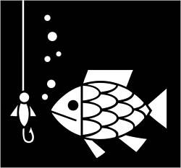
Fishing hints
Some helpful hints:
        Stay in the boat or on the rocks. In the water you’ll only get wet and cold.
        If the fish aren’t biting cast around.
        To go after big fish you’ll have to cast in deep water
You’ll have a few disappointments, Come back another time.
Be creative. It’s not the size of the hook or the thickness of the line but how you play the game that is important.
back . . .

Slide 59


CONTINUUM OF SCHOOL-WIDE
INSTRUCTIONAL &
POSITIVE BEHAVIOUR SUPPORT
Tertiary Prevention:
Specialised
Individualised
Systems for Students with High-Risk Behaviour
5%
15%
Secondary Prevention:
Specialised Group
Systems for Students with At-Risk Behaviour
Primary Prevention:
School/Classroom-Wide Systems for all Students, Staff, & Settings
Non-violent crisis intervention
80% of Students

Slide 60
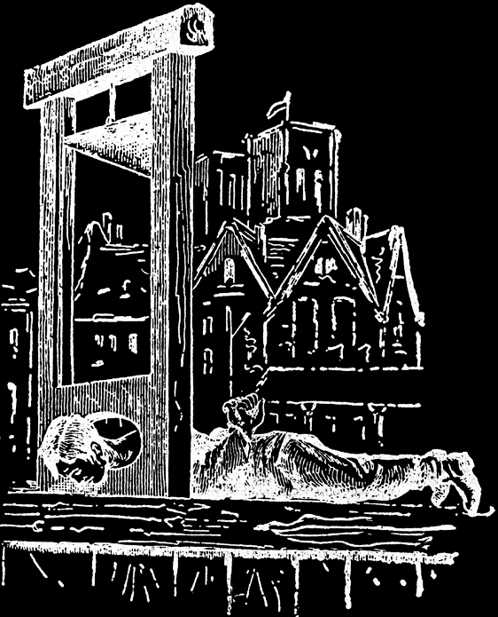
Transparent Options
no real choice provided
obvious distinctive between ‘right’ and ‘wrong’ choice
lack any dilemma for the client
are judgemental
reflect frustration rather than calm control
back . . .

Slide 61
Legal #40 continued
Implications of Risk Management
Legal Bulletin No. 40
. . . In accordance with the Occupational Health and Safety Act, staff must be consulted at all stages of the risk assessment process. The staff who must be consulted are those whose safety may be affected by decisions concerning the risks, particularly concerning how the risks are to be managed.
Typically the primary measure to deal with the risk of violence from a student will be a behaviour management plan. This should be formulated in close consultation with the staff, including teaching and support staff who will be teaching or otherwise have frequent contact with the student. . . .

Slide 62

Function assessments
.
.
.
.
Functional behavioral assessment is
* a process of looking for patterns in what happens around and/or to the student just before and just after the problem behaviour
* an examination of these patterns to identify their purpose or their "function" some possible functions are: avoiding something, getting something, and making something happen
* a creative problem solving to enable the student to achieve the same purpose in a more appropriate or more acceptable way
From: http://www.teach-nology.com/tutorials/teaching/fba/

Slide 63
.
.
.
.
Functional behavioral assessment is NOT
* the first technique a teacher uses when a pupil misbehaves
* a quick fix
* a do-it-yourself technique - it takes collaboration
From: http://www.teach-nology.com/tutorials/teaching/fba/

Slide 64
Conducting a Functional Behaviour Assessment
Two Parts
Part A - Setting the scene
Part B - Getting the details
Time
Using the Target routine determine the:
Activity and staff involved
Likelihood of problem behaviour occurring
Antecedents
Consequences
Problem behaviour
Setting events
Current intervention
Summary of behaviour
Defines target routine or behaviour most likely to occur.

Slide 65
SUMMARY OF BEHAVIOUR
During
<insert target routine> ,
<insert student name>
is likely to
<insert problem behaviours>
when (s)he is
<insert details of antecedent conditions that trigger behaviour>,
and you believe that (s)he does this to
<insert details of consequence/function>.

Slide 66

Negotiation
Negotiation Skills
- getting past no
no
no
no
1. don’t react
2. don’t argue, agree/acknowledge
3. use the key question
4. reframe the question to wear down resistance
5. look at the options
Use the key question . . . .
What can I do to ?
(get what I need)

Slide 67
AN EXAMPLE OF SOME PRIMARY SCHOOL
CLASSROOM MANAGEMENT STRATEGIES
STEPS
STRATEGIES
Tactical ignoring (low level)
Reinforce on-task behaviour
Look past disruptor
Non-verbal message
Eye contact, shaking head, pointing, etc.
Close proximity to child
Casual statement
How are you going?
Any problems?
Diffusion
Use of humour
Simple direction (reminder)
Use student's name
Use excuse me, please, thank you
Eye contact, firm
Question and feedback
What are you doing? What should you be doing?
Non-threatening
How's it going?
from Behaviour Management in Queensland Schools (2000) at www.btr.qld.edu.au

Slide 68
STEPS
STRATEGIES
Rule restatement/reminder
Quietly remind of established rule
Brief and clear
Take a pupil aside
(quiet discussion)
Call over quietly
Brief discussion
Student needs to know what should be done when they return
Deflection
Teacher acknowledges child frustrated/angry but refers back to appropriate behaviour
Clear desist or command
Explain that behaviour is unacceptable and direct them to resume task
Simple choice
"It's your choice"
Work quietly or move
I'll have to ask...
Final warning
from Behaviour Management in Queensland Schools (2000) at www.btr.qld.edu.au

Slide 69
STEPS
STRATEGIES
Isolation to "Thinking Chair"
Ask to move to "thinking chair" (3-5 minutes)
Isolation to "Cool-Off Area"
5-15 minutes
Simple choice first
Cool off or isolation
Reflect on own behaviour
Return when ready to obey fair rules
Relocation to Buddy Classroom
Complete Reflection Sheet
Work in buddy teacher classroom for remainder of session
Discuss re-entry with class teacher prior to commencement of next session (verbal agreement)
from Behaviour Management in Queensland Schools (2000) at www.btr.qld.edu.au

Slide 70
8
Assertive Discipline – Canter & Canter
features
Clear set of observable, class negotiated rules. Only 3 - 5 max.
For behaviour that breaks the rules a clear, pre-determined set of consequences are laid out.
Focus on positive behaviour with constant reinforcement through comments and recording of compliance.
All students are targeted for both positive recognition and negative consequences when relevant.

Slide 71



9
CLASS RULES
No talking when the teacher is talking
Stay in your seats
Keep your hands and feet off other people and their property
Follow the instructions given by the teacher
CLASS CONSEQUENCES
1st incident name on board - 1st warning
2nd incident tick - 2nd warning
3rd incident tick - stay back after class
4th incident tick - lunch time detention
5th incident tick - leave the class, interview with head teacher/AP
CLASS RULES
No talking when the teacher is talking
Stay in your seats
Keep your hands and feet off other people and their property
Follow the instructions given by the teacher
CONSEQUENCES
1st name on board - 1st warning
2nd tick - 2nd warning
3rd tick - stay back after class
4th tick - lunch time detention
5th tick - leave the class, interview with head teacher/AP

Slide 72
10
CLASS RULES
No talking when the teacher is talking
Stay in your seats
Keep your hands and feet off other people and their property
Follow the instructions given by the teacher
Caleb


Fabio

Suzie
Jack

Bashir

Shannon
Is it worth it?
Carly


Jess
CONSEQUENCES
1st name on board - 1st warning
2nd tick - 2nd warning
3rd tick - stay back after class
4th tick - lunch time detention
5th tick - leave the class, interview with HT/AP




Ryan
Hassan

Tamika
Lucas

Slide 73
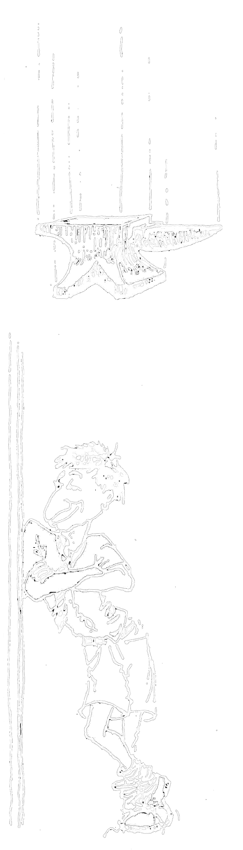


11
Talk sense to yourself
Jeff Wragg
?
Think consequences
Is it worth it?
What do I need to say to myself?

Slide 74
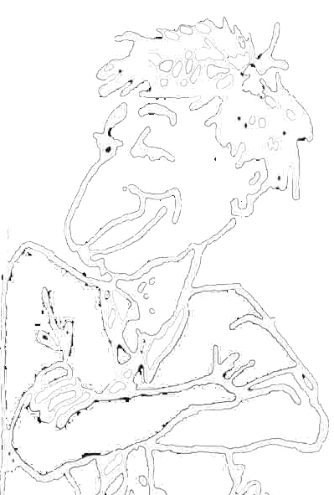
THINKING
12
This is boring
STOP
School sux
Think consequences
I didn’t do nothing
Just get through this and then it is recess
They always pick on me
It’s not worth it

TALKING TRASH
TALKING SENSE TO YOURSELF
ACTIONS – What am I doing?
hard
Talking in class
Throwing things
Talking back to teachers
Hassling other kids
CONSEQUENCES – What happens?
✓
✗
Mum gets upset
✗
✓
Sent out
Suspension
✓
✗
Detention
Interview with principal
IS IT HELPING ME? IS IT WORTH IT?
YES / NO

Slide 75
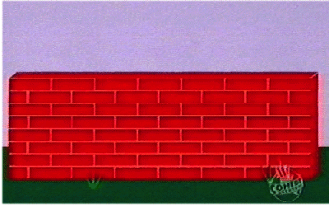
13
Anyone
Start fighting and yelling
10
STOP
Think Consequences
Is it worth it?
9
8
Throwing things
Swearing
Hitting out
Walk over and push them
7
6
Push back and call me a wanker
5
Answer back
Out of control
4
Feeling good
3
Keep saying things
Mention my mum
2
Get called names
1
0
In control
back

